Slide 1
Eye contact? Devilishly effective.
Company, event, date
Name

Slide 2
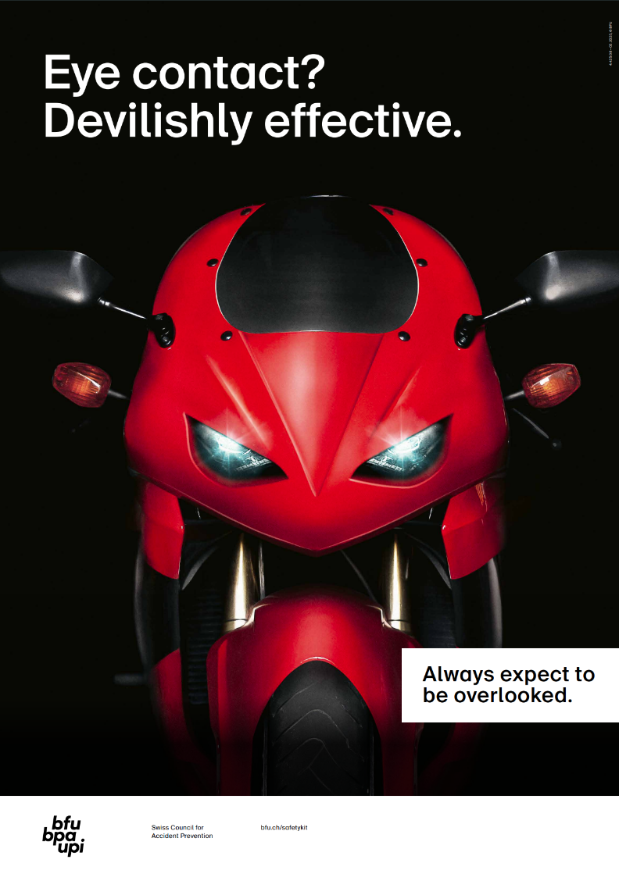
Whether you’re commuting to work on a scooter, heading out for a leisurely ride on a chopper or crossing a mountain pass on a sports bike – whatever you ride, unfortunately there’s always an accident risk.
Here’s how to get to where you want to go on your motorbike safely:

Slide 3
Safety starts when you buy
Determine which bike is the best fit for you in terms of size, weight and centre of gravity, sitting position, performance and handling.
Get advice and compare different models.
Choose a motorcycle with ABS or cornering ABS.
Invest in driver assistance systems.
Notes:
Zwar ist ABS bei neuen Motorrädern gesetzlich vorgeschrieben, doch es sind noch immer viele ältere Modelle ohne ABS im Umlauf oder stehen als Occasion zum Verkauf.

Slide 4
Get the season off to a safe start
Check your motorcycle and equipment: Tyres, brakes, chain, lights, oil levels, suspension struts, cockpit and personal protective equipment
Start by taking short rides.
Expect to be overlooked by other road users, especially at the start of the season.
Refresh and practise your cornering and braking skills.

Slide 5
The right equipment is a matter of life and death
Motorcycle helmet (full-face and flip-up helmets afford the best protection)
Gloves made of abrasion-resistant material
Abrasion-resistant motorcycle clothing with protectors or airbag vest
Motorcycle boots
And: clothing in eye-catching colours, with reflective elements and an additional high-visibility vest, boost visibility.

Slide 6
Always expect to be overlooked
Motorcyclists are often overlooked by other road users due to their narrow silhouette – especially at intersections and junctions. On top of this, other road users often find it difficult to accurately estimate the speed and distance of motorcyclists.
Look ahead and ride defensively.
Adapt your speed.
Always obey the traffic rules.
Make eye contact with other road users.
Be ready to brake.

Slide 7
Turning the corner
A motorbike that is cornering correctly is as wide as a regular car.
Lean into the bend correctly (don’t cut corners).
Adapt your speed to the bend.

Slide 8
Braking correctly
If you can’t brake correctly, you are giving away potentially life-saving metres.
Practise braking until reacting correctly becomes second nature.
Practise braking even if you’re an experienced motorcyclist.

Slide 9
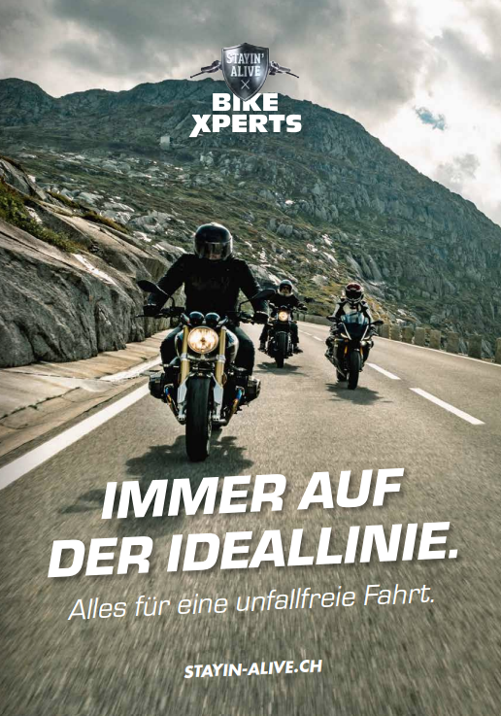
Find more accident prevention tips
Order free of charge: bfu.ch/bestellen

