Slide 1
Be smart, be seen!
First and last name, job title
Date, event

Slide 2
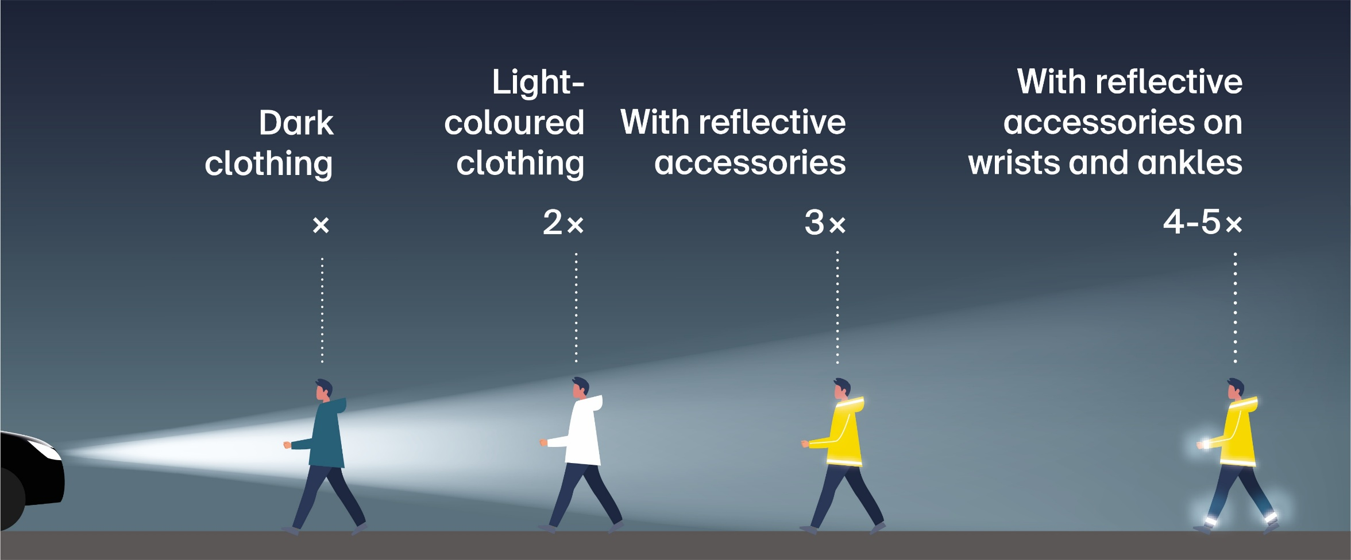
Reflect and make sure you stand out.
Notes:
If you are on foot in the dark wearing light-coloured clothing, you will be seen from twice as far away as if you are wearing dark clothing; if you are wearing reflective clothing or accessories, you will be seen from at least three times as far away. People who wear reflective accessories on their wrists and ankles stand out even more. This increases their chance of being seen by a factor of four to five.

Slide 3
Be smart, be seen: on foot and while running
  Wear light-coloured clothing.
  Kit yourself out with reflective materials that make you visible from all around.
  Wear reflective accessories, especially on moving body parts (arms and legs).

Slide 4
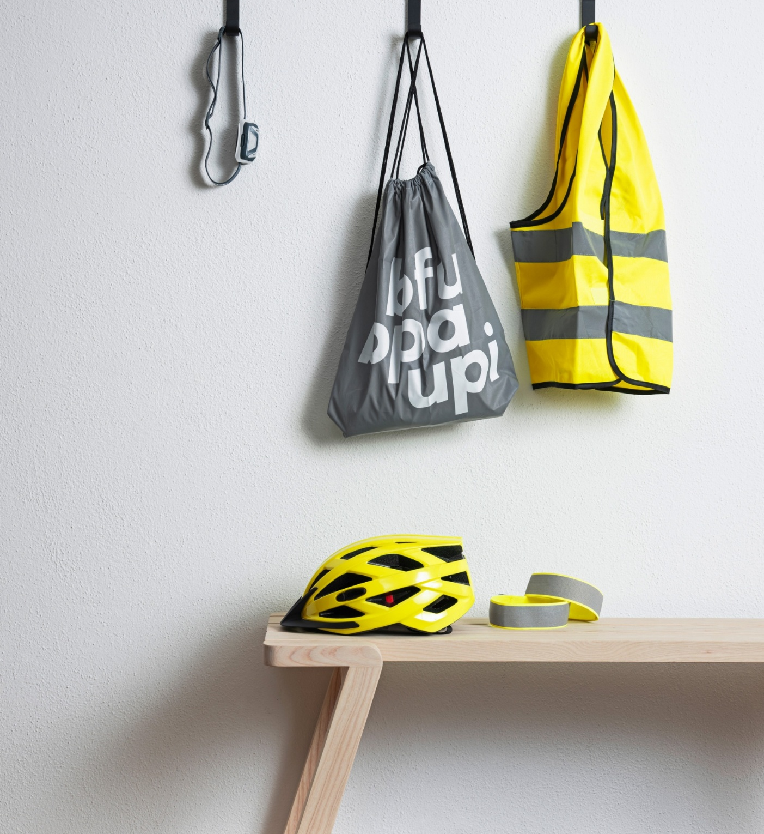
Be smart, be seen: on a bicycle or e-bike
  Equip your bicycle with the lights required by law: e-bikes must have their lights switched on throughout the day and night.
  Attach spoke reflectors or fit reflective tyres for an additional layer of safety.
  Wear light-coloured clothing, bright colours and reflective materials, such as high-visibility vests and reflective arm and ankle strips.

Slide 5
Be smart, be seen: on a kick scooter, skateboard and co.
  In the dark or in poor visibility: use lights.
  Lighting is mandatory for road-approved e-scooters – in daytime too (daytime running lights).
  Wear light-coloured clothing, bright colours and reflective materials, such as high-visibility vests and reflective arm and ankle strips.

Slide 6


Slide 7
Be smart, be seen: while driving a car or riding a motorcycle
  Driving with switched-on lights is mandatory.
  Keep your headlights clean.
  A clean windscreen and rear window ensure a clear view.
  On a motorcycle: wear light-coloured clothing, bright colours and reflective materials.

Slide 8

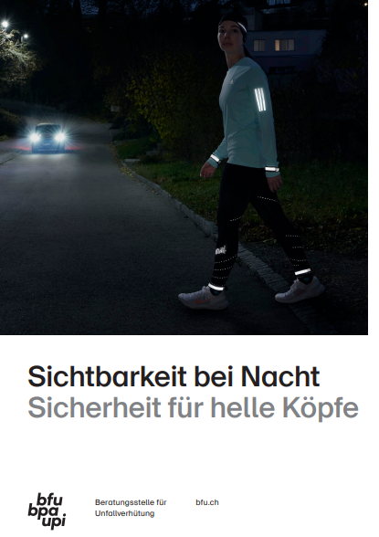
Find more accident prevention tips
Order free
of charge:
bfu.ch/bestellen

