Slide 1

Football, volleyball, handball, basketball, unihockey or tennis:
Ball sports are popular.

Slide 2
But accidents can and do happen
448 000
Sports casualties
132 000
Ball sports casualties
Source: Status Report 2025; UVG Statistics 2022

Slide 3

Casualties by type of sport
Type of sport | Casualties
Football | 80 000
Basketball | 10 000
Volleyball | 9 500
Field hockey, roller hockey, unihockey | 9 000
Tennis | 6 000
Handball | 5 500
Badminton | 2 000
Squash | 500
Other ball sports | 9 500
Total | 132 000
Source: STATUS Report 2025, UVG 2022 / Getty Images “Tom Werner/DigitalDivision”

Slide 4

The right equipment
  Appropriate protective gear:
  Shin pads with ankle protection, knee pads,
  sports safety glasses
  Footwear: good fit, lateral support, non-slip soles,
  sufficient shock absorption
  Goalkeepers: full, intact kit (a helmet is essential)
  Sport-specific equipment (e.g. tennis racket):
  get expert advice on size, tension and footwear
Getty Images “Nicolas Ospina/iStock”

Slide 5
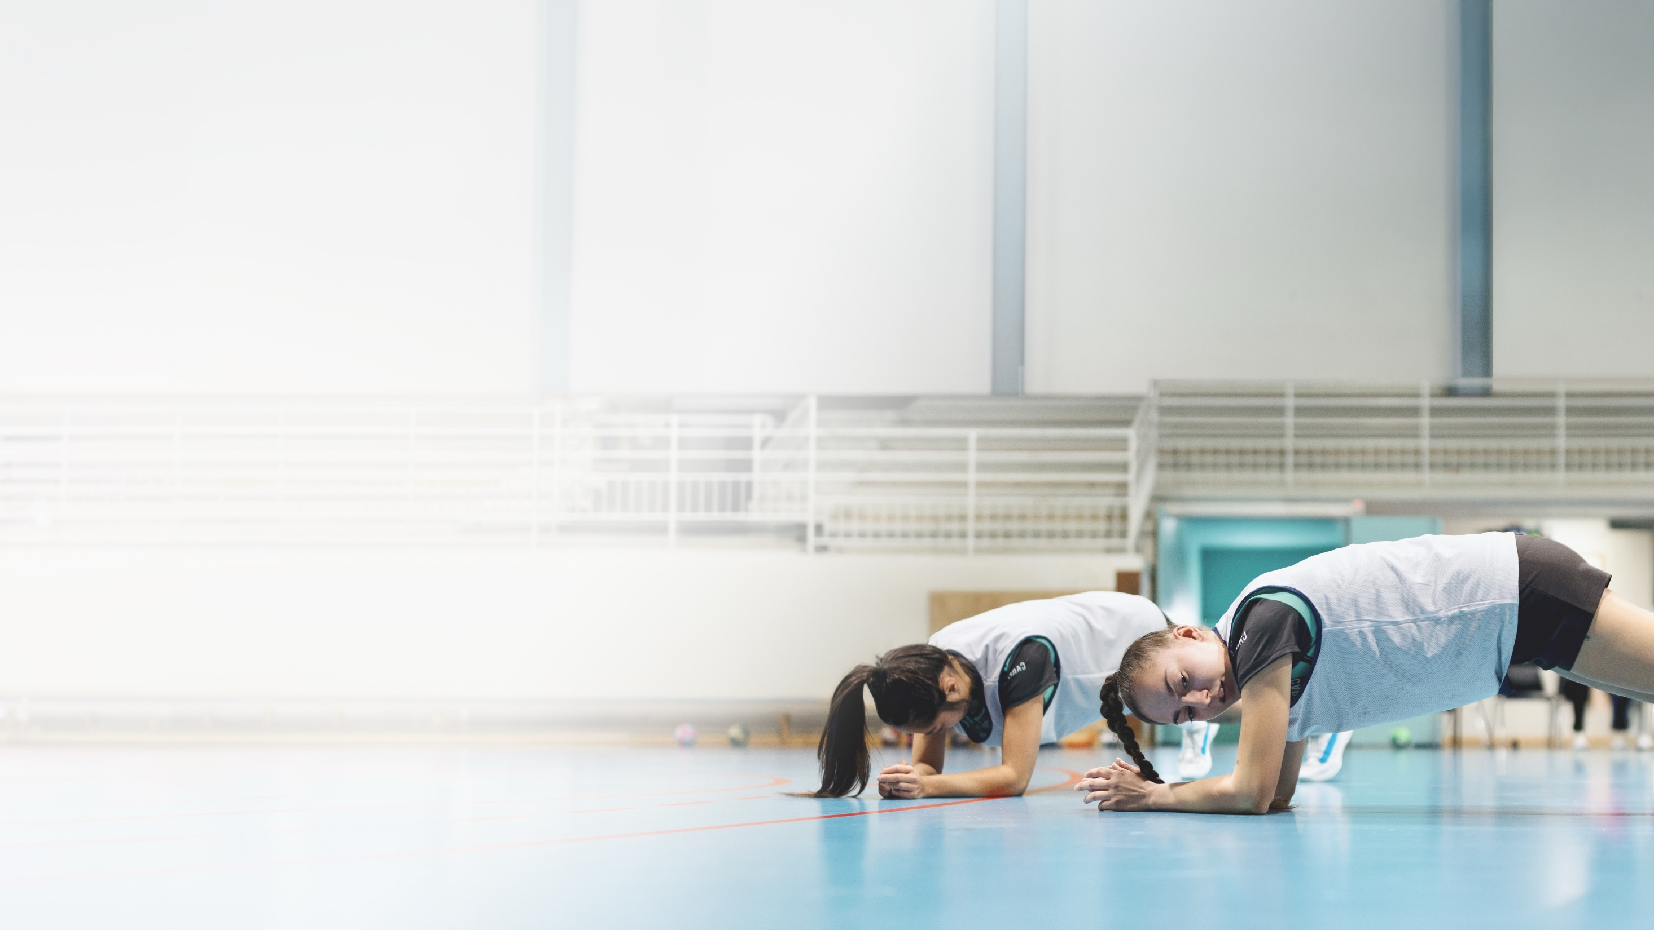
Warming up
  Substitute players:
  warm up again briefly before joining the game
A thorough warm-up is essential before each session:
  Dynamic mobilization
  Activating the core muscles
  Sport-specific stabilization exercises
  for foot, knee, hip and shoulder joints
  Incorporating strength, speed and
  explosiveness
Getty Images “Anchiy/E+”

Slide 6
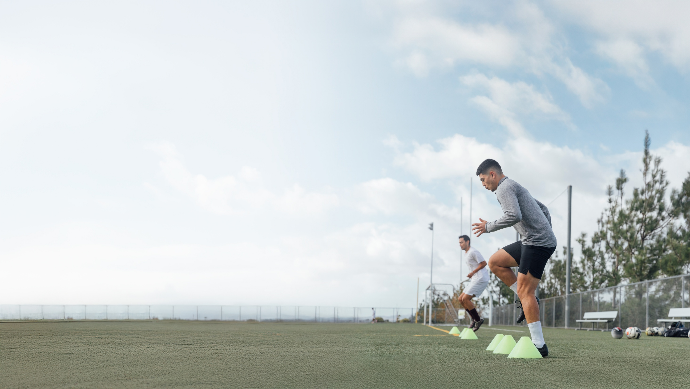
Training
  Strength and balance exercises
  for the upper body and legs
  Coordination, jumping and landing exercises
  with the correct technique
  Steadily build up technical and tactical aspects
  Regular breaks and sufficient fluid intake
  A controlled, realistic training load
Getty Images “The Good Brigade/DigitalVision”
Notes:
(ein- bis zweimal pro Woche)
Qualität vor Quantität)

Slide 7
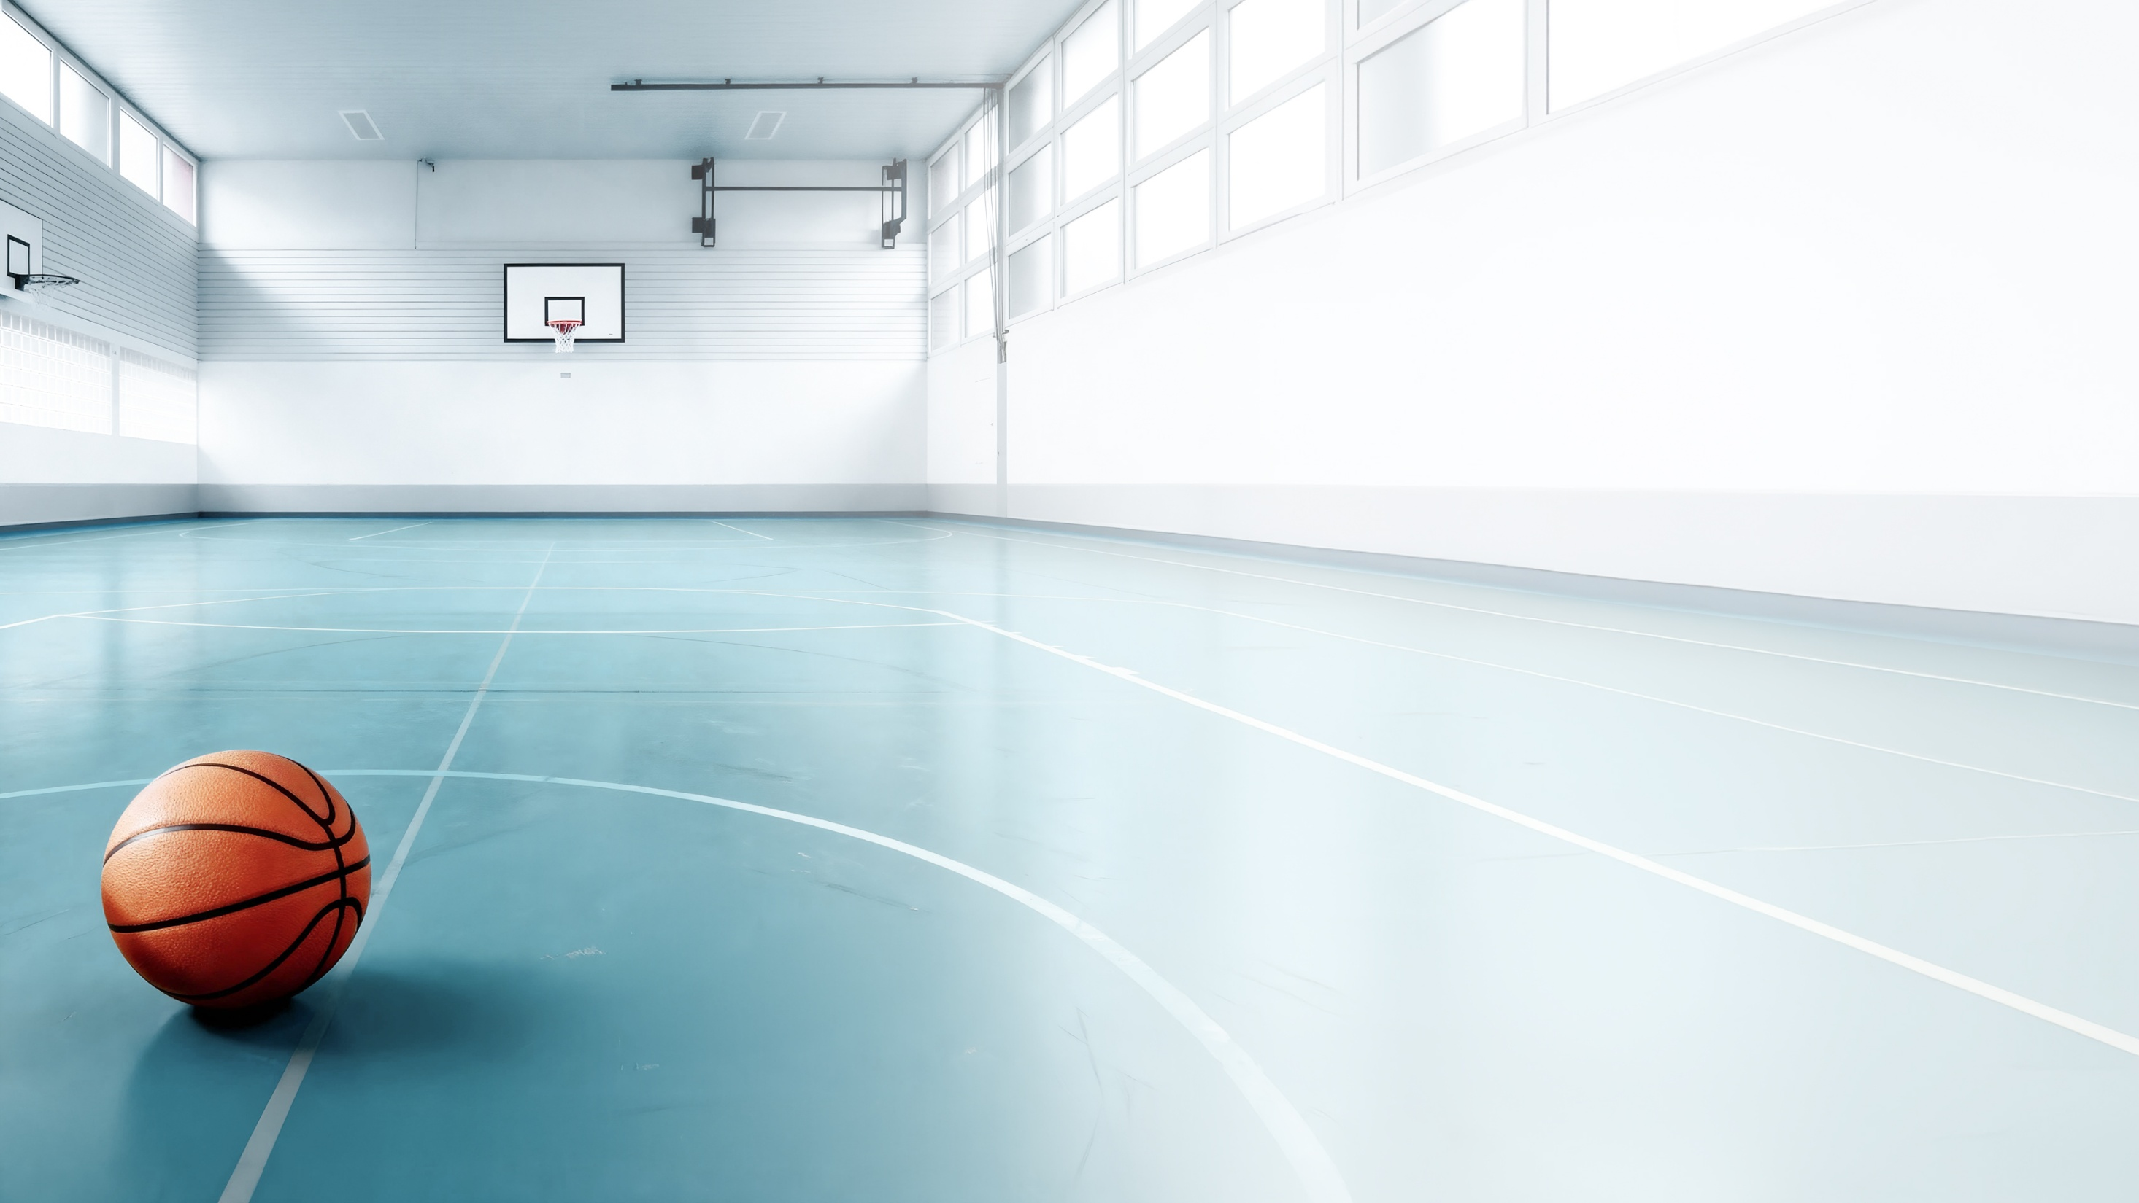
Environment
  Don’t play on wet or slippery surfaces
  Keep the playing field tidy – clear away any discarded balls
  Ensure clear team communication
  Fairness and consideration in one-on-one situations
  Consistent fair play

Slide 8


Returning to training after injury
  Make a gradual return, ideally accompanied
  by specific return-to-play measures.
  Ankle protection after ankle injuries is strongly
  recommended (e.g. bracing or taping)
  If pain, swelling or instability occur: reduce the
  burden, seek expert advice if necessary
Getty Images “Marc Calleja Lopez/iStock”

Slide 9
More accident prevention tips:
bfu.ch

