Slide 1
Don’t be thrown off track!
SafetyKit Sledding
Company, event, date

Slide 2
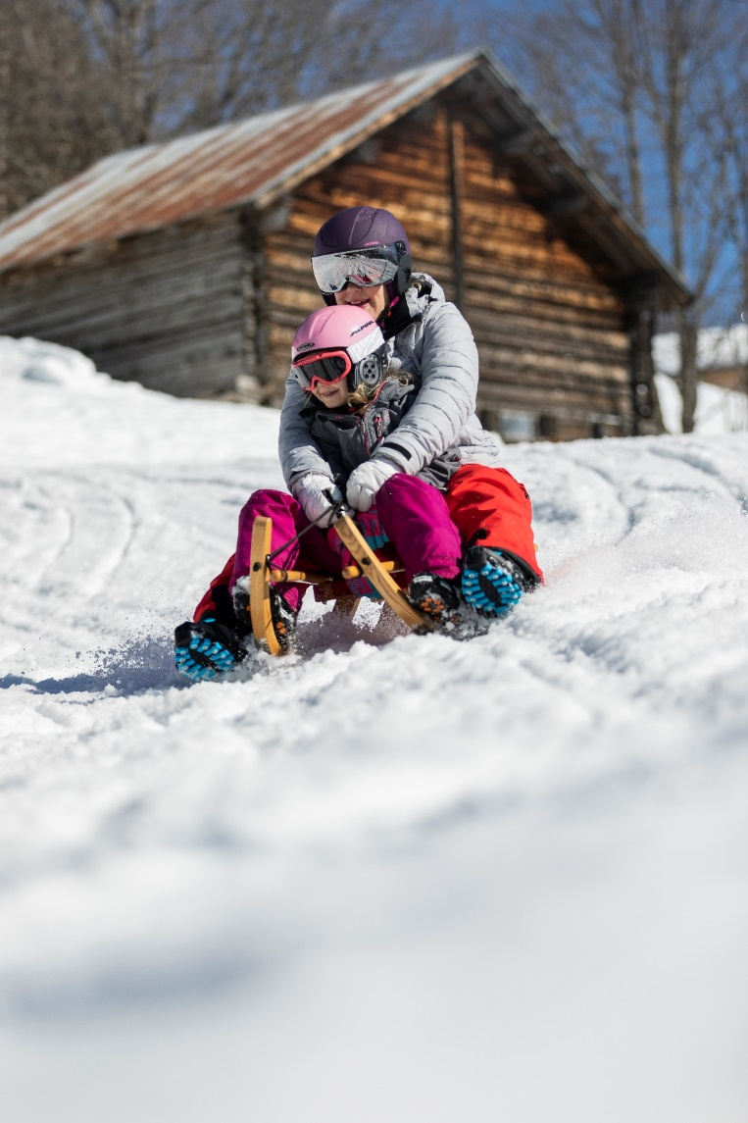
Ready, steady, go! Let your sled run and feel the snow swirling on your face – sledding is fantastic fun for all the family.
The other side of the coin is that every year, 6500 sled rides end at a doctor’s surgery.

Slide 3
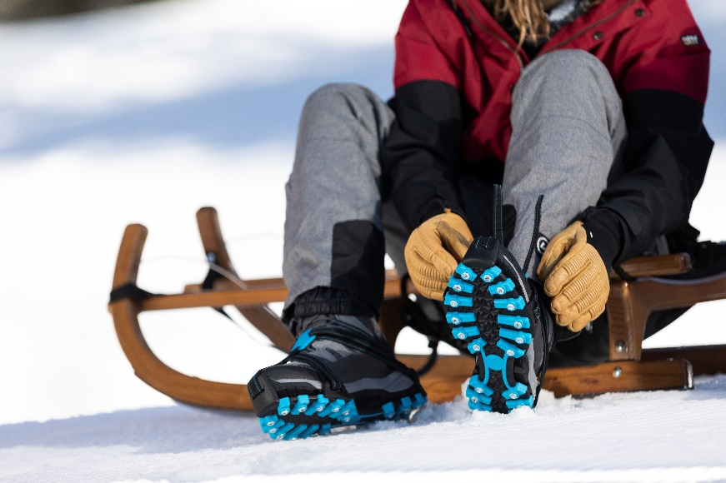
The right equipment
Helmet and ski goggles
Boots with a high shaft and good treads. We also recommend braking aids, especially in icy conditions.
Winter jacket, ski/snow trousers and gloves
Sled in perfect condition

Slide 4
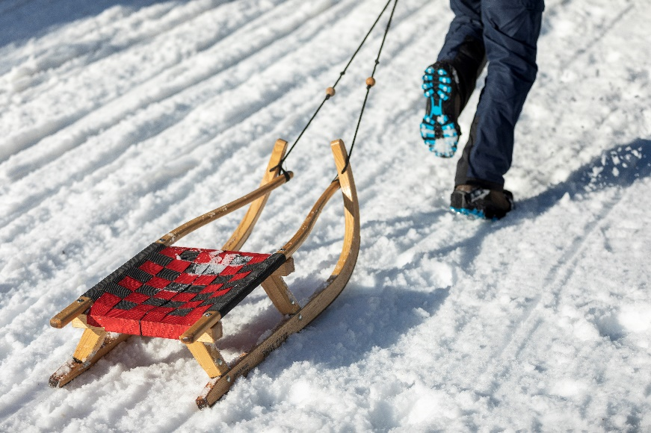
The ideal sled
Only sports sleds ensure accurate steering on hard and icy surfaces.
Wooden sleds with stiff, flat runners have poor steerability.
A plastic bob can only be controlled on soft, wet snow. On hard and icy surfaces, it will pick up speed very fast, making braking and steering difficult.
Choose a sports sled for better steerability.

Slide 5
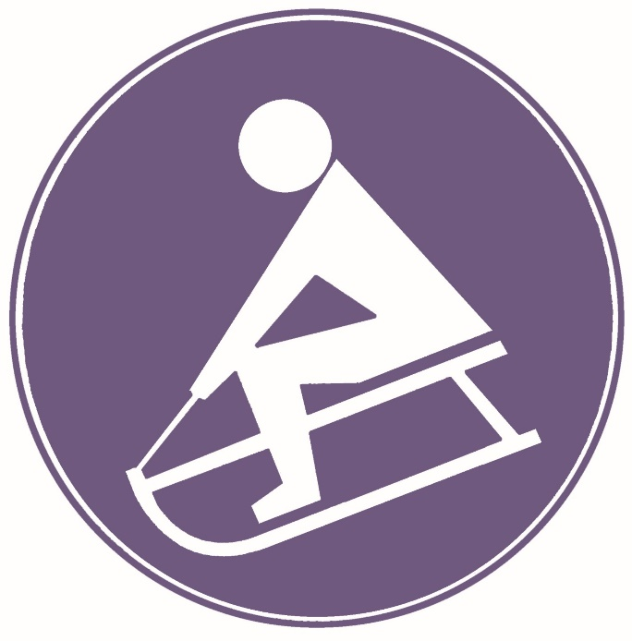
Where can I sled?
On obstacle-free slopes and trails (no walls, fences, pedestrians, motor vehicles).
Specially signposted sled runs and trails are ideal.
Sledding on snow sports slopes is normally prohibited.

Slide 6
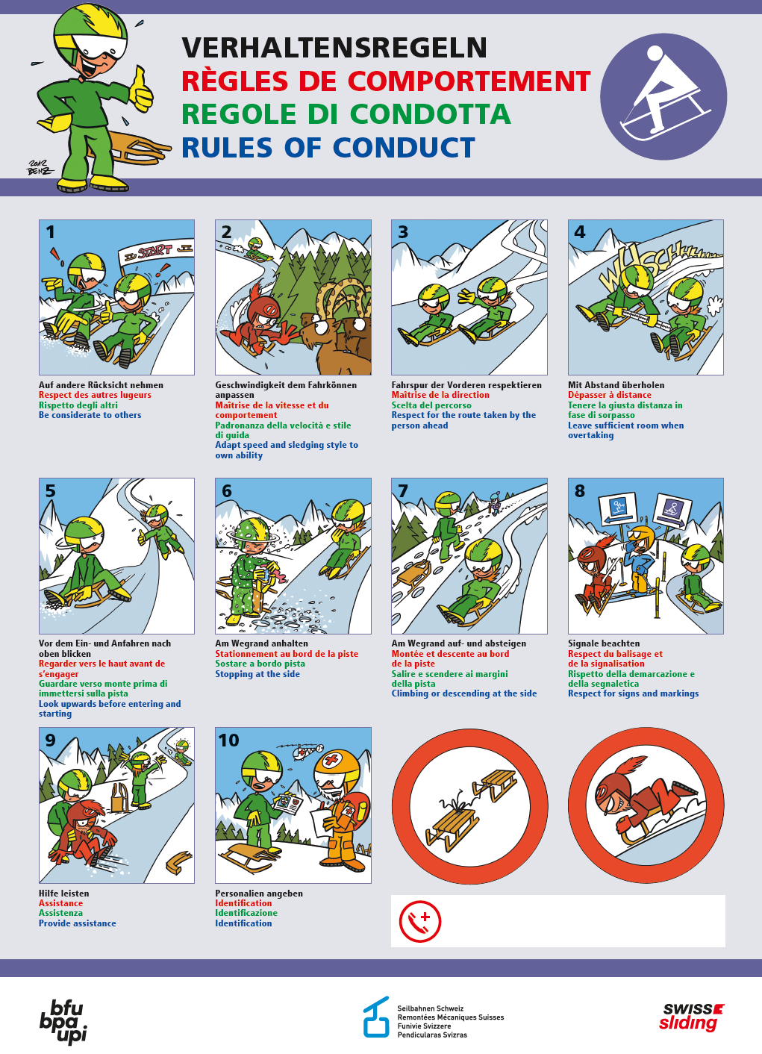
10 sledding rules of conduct
Be considerate of others
Adapt your speed and style to suit your ability
Respect the route of the person ahead of you
Leave sufficient room when overtaking
Look uphill before entering or starting a run
Always stop at the side of the run
Always climb or descend at the side of the run
Follow the signage and markings
Provide assistance
In the event of an accident: provide contact details

Slide 7
Video «Sledding» (available in French, German and Italian)

Slide 8
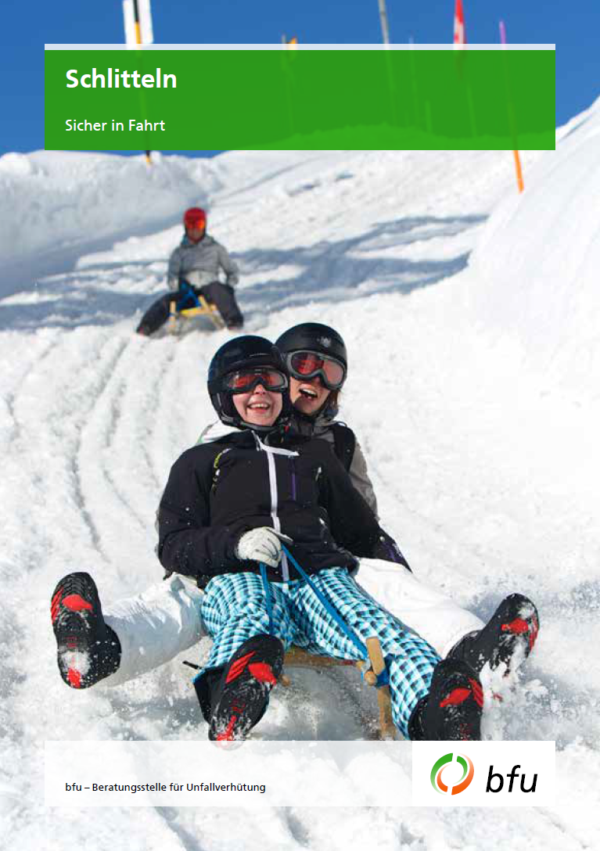
More information
Get more information on this topic in the BFU brochure
«Sledding» (Art. 3.001 - available in French, German and Italian):
Order it free of charge at bestellen.bfu.ch.
Find more accident prevention tips at bfu.ch.

