Slide 1
Don’t get burnt!
Company, Event, Date
Name

Slide 2
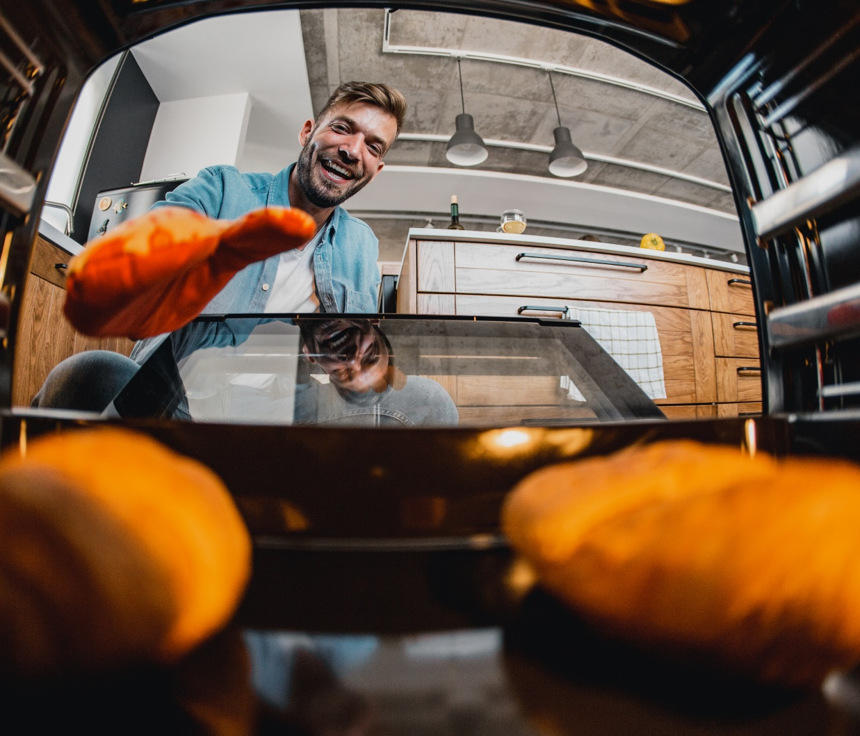
  Boiling water, stove tops, ovens and barbecues – as soon as heat and flames come into play, the risk of injury isn’t far away.
  Every year, 8000 people in Switzerland are injured by burns or scalds.
© Getty Images

Slide 3
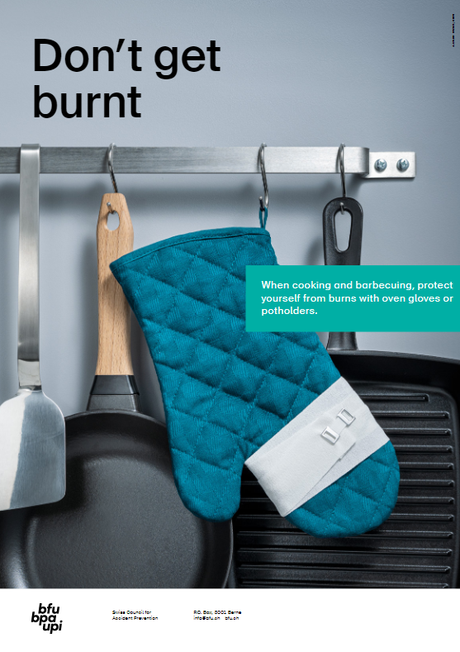
In the kitchen
  Protect your hands with oven gloves or pot holders.
  Use the back rings on the stove whenever possible.
  Turn pan handles backwards (away from you).
  Place countertop electrical appliances close to the wall and roll up power cords when not in use.

Slide 4
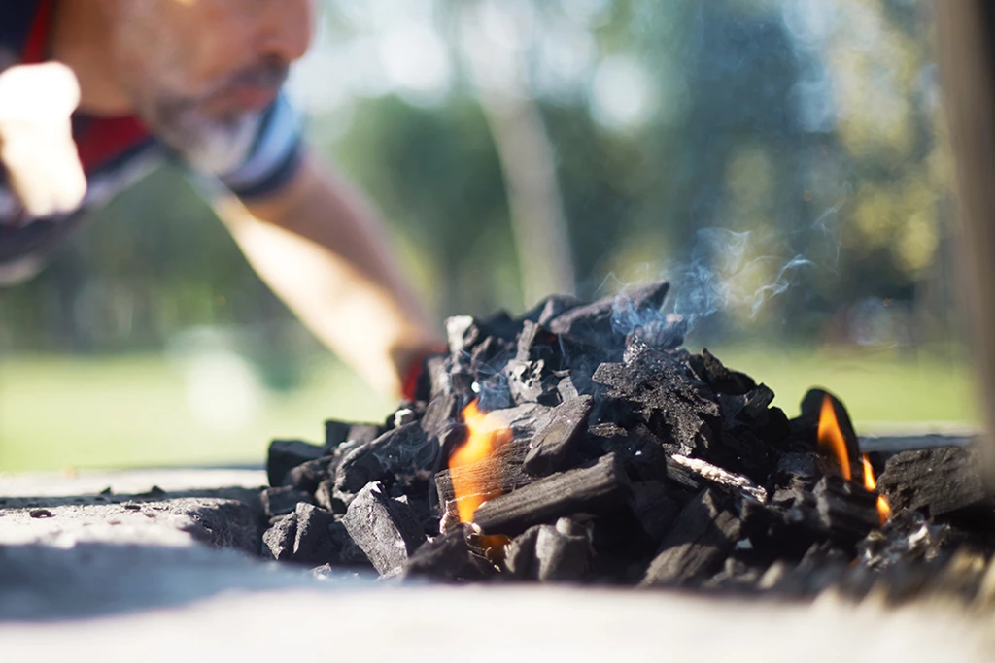
Barbecuing: charcoal and gas barbecues
  Place the barbecue outdoors on a stable surface.
  Make sure there is sufficient distance between the barbecue and anything flammable.
  Always supervise children and pets near a barbecue.
© Getty Images

Slide 5
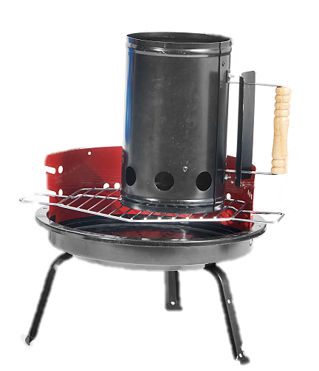
Barbecuing on charcoal grill
  Always light the barbecue with ignition cubes, fuel paste or a chimney starter.
  Let the embers cool down in a fireproof container (for at least 48 hours).
  Do not put the barbecue away until it has completely cooled down.

Slide 6
Barbecuing on a gas grill
  Always operate the barbecue and gas bottle according to the instructions.
  Check gas hoses and connections regularly for leaks. Coat the hose with soapy water or leak detection spray; bubbles will indicate leaks.
  Replace damaged, brittle or cracked gas hoses.
  Close the valves if you smell gas.
  Never store gas bottles below ground floor level/in a cellar; it is better to store them outdoors away from direct sunlight.

Slide 7
Burn first aid
  Minor and superficial burns:
  Remove clothing or other objects from the injured area immediately. If there is fabric sticking to the burnt skin, do not remove it.
  Immediately cool the affected area with lukewarm, running water for at least 15 minutes.
  After cooling, make sure the wound is clean and cover it with a bandage if necessary.

Slide 8
Burn first aid
Major and severe burns:
  Dial the emergency number 144 immediately.
  Wrap the injured person in a foil space blanket to prevent the loss of body heat.

Slide 9

Video «Burns»

Slide 10
More information
Find more accident prevention tips at ratgeber.bfu.ch and bfb-cipi.ch.

