Slide 1
Standup paddleboarding – the smart way
Company, event, date
Name last name

Slide 2
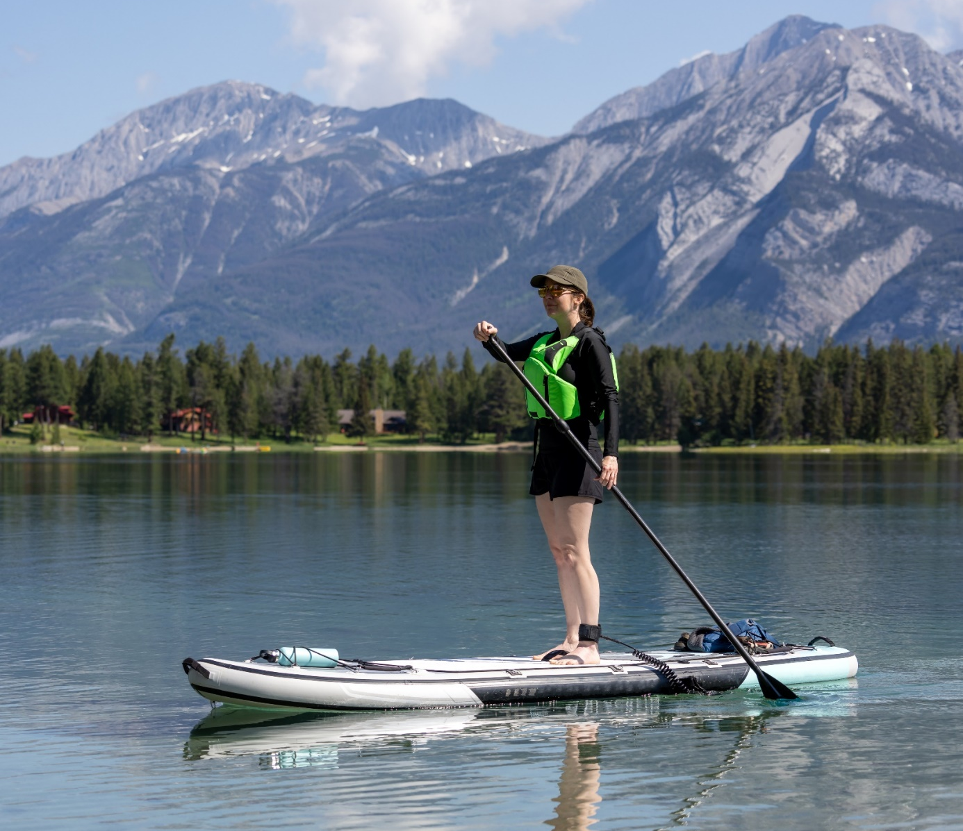
Exercising, relaxing, appreciating new views from the water: standup paddleboarding has become a popular activity on Swiss lakes.
However, this sport looks easier than it is. Risks arise particularly from falls into cold water, headwinds and strong currents.
Image source: Gettyimages

Slide 3
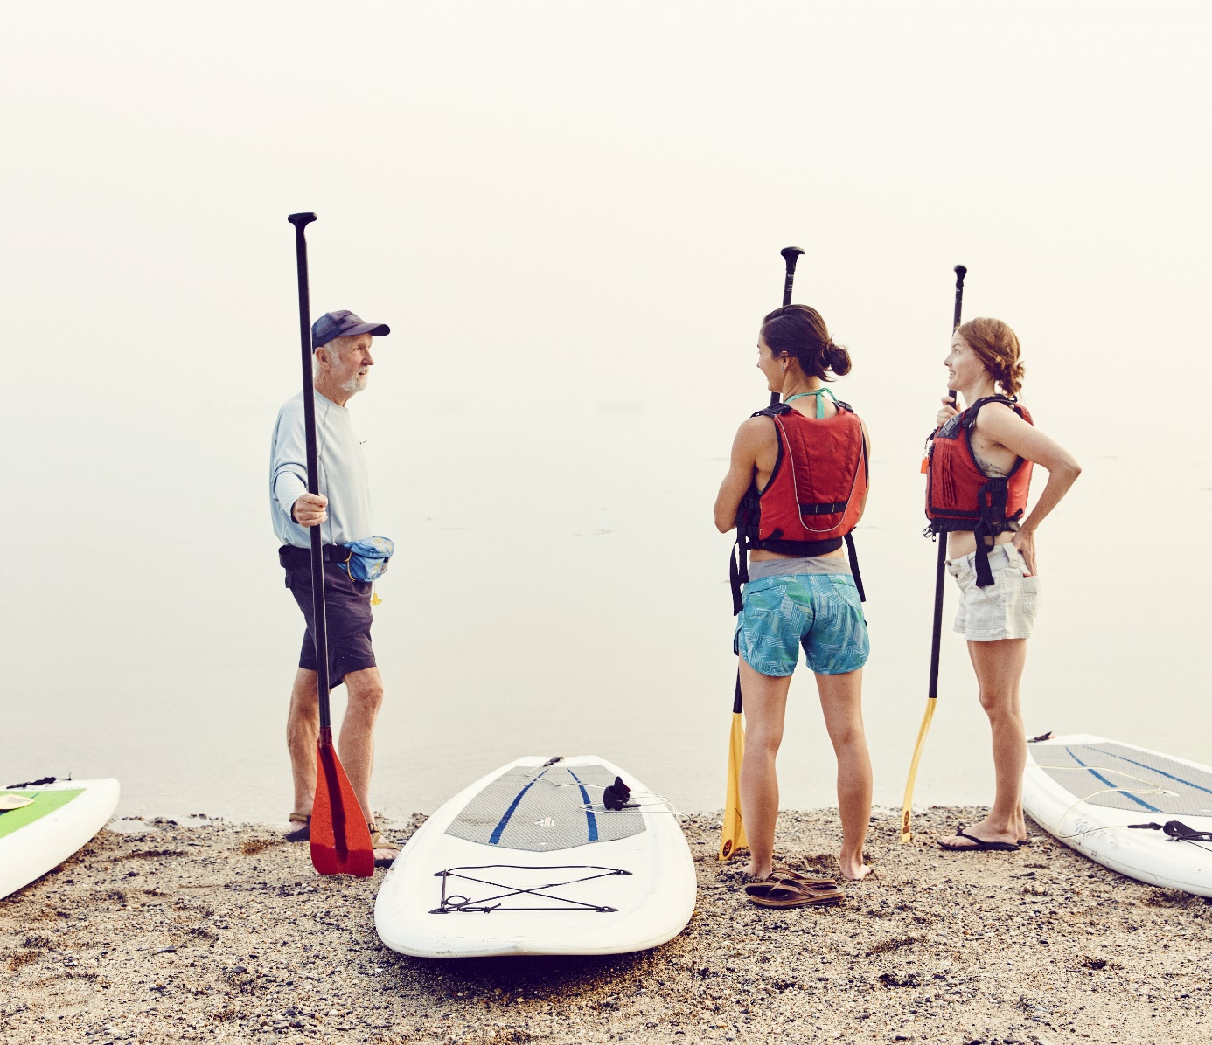
Be prepared
  Take an induction course.
  Plan your SUP tour carefully.
  Check the weather forecast and conditions.
  Don’t set out alone.
  Let someone know where you plan to go.
Bildquelle: Getty Images
Image source: Gettyimages

Slide 4
Well equipped
  Suitable life jacket
  Weather-appropriate clothing (e. g. wetsuit in cold weather)
  Enough to drink
  Sunscreen
  Mobile phone (in waterproof packaging)
  Required by law:
  At night and in poor visibility: light (visible from all angles)
  Label the SUP with the name and address of the owner

Slide 5
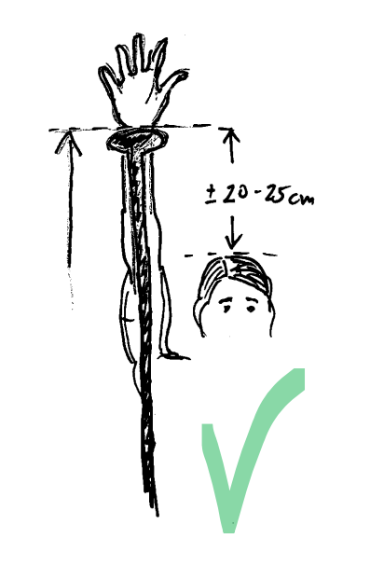
Well equipped
  Choose the right board:
  the wider, the more stable – the longer, the faster
  Adjust the paddle:
  body height +/– 20 to 25 cm = paddle length

Slide 6
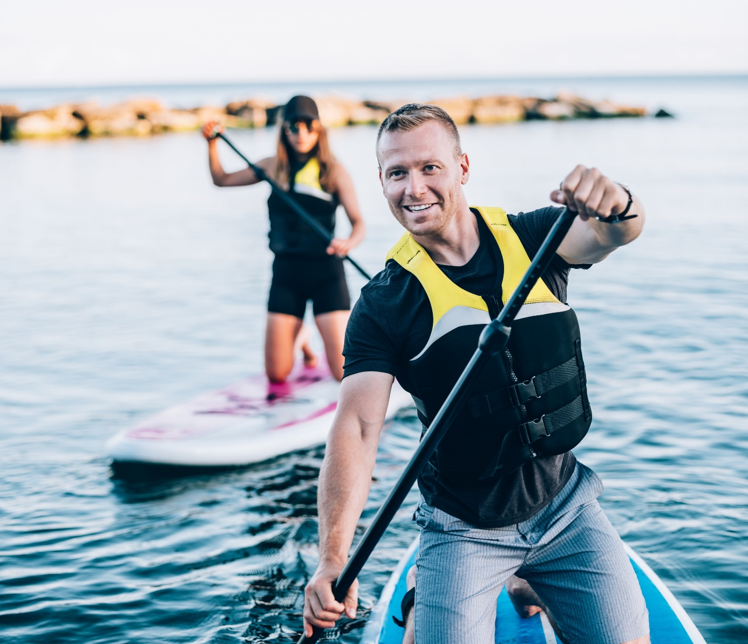
On the move
  Always carry the board fin-first to the water’s edge.
  When going out on the lake, attach the leash to your ankle – but never in flowing water: if you get caught, the current will push you underwater.
  Kneel to paddle from the shoreline into open water. Don’t stand up until the water is at least 1 metre deep.
Image source: Gettyimages

Slide 7
On the move
  Pay attention to the wind direction: always set off against the wind.
  Keep sufficient distance from other vessels.
  Observe the right-of-way rules for boats.
  Don’t go into restricted areas (yellow buoys). This is strictly forbidden!
  Keep at least 25 metres away from reeds and aquatic plants.
  Refrain from drinking alcohol.

Slide 8

Video Standup paddleboarding

Slide 9
More information
Find more accident prevention tips at bfu.ch.

