Slide 1
Reflect and make sure you stand out.
Company, Event, Date
Name

Slide 2
On foot, your accident risk in the dark is twice as high as during the day. On a bicycle or e-bike, it is 1.5 times higher.

Slide 3
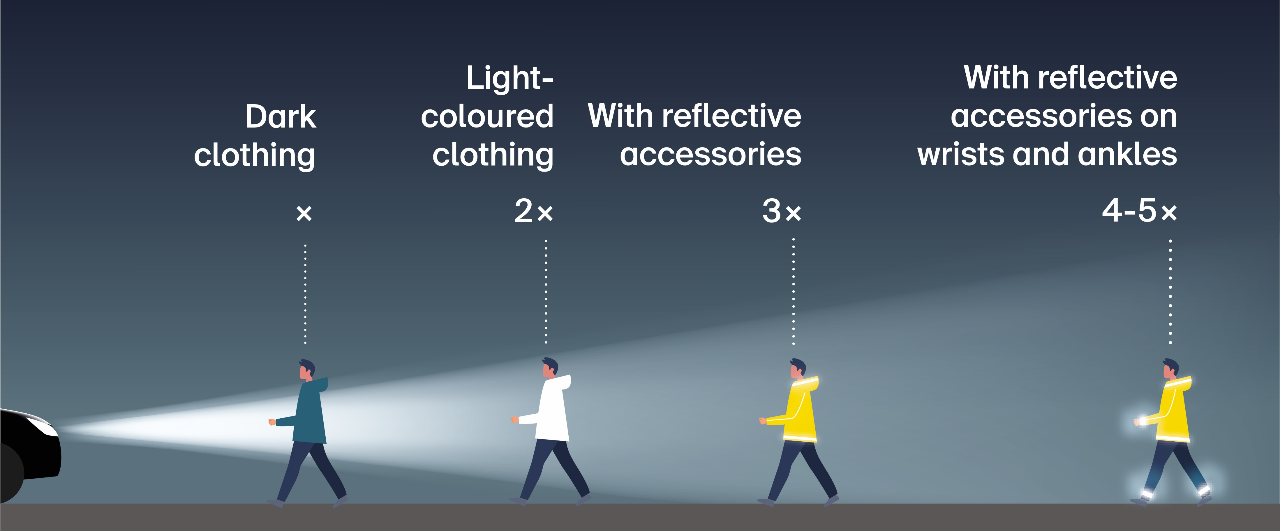
Reflect and make sure you stand out.
Notes:
If you are on foot in the dark wearing light-coloured clothing, you will be seen from twice as far away as if you are wearing dark clothing; if you are wearing reflective clothing or accessories, you will be seen from at least three times as far away. People who wear reflective accessories on their wrists and ankles stand out even more. This increases their chance of being seen by a factor of four to five.

Slide 4

  Video «Be visible»

Slide 5
Be visible when out and about – on foot and while jogging
  Choose clothing that is as light-coloured as possible.
  Equip yourself with reflective materials that are visible from all angles.
  Wear reflective accessories, in particular on moving body parts (legs, arms), since they are constantly in motion.

Slide 6
Be visible when out and about – on a bicycle or an e-bike
  Equip your bicycle or e-bike with regulation-compliant lights.
  Add spoke reflectors or reflective tyres.
  Wear reflective clothing or accessories.
  Switch on the lights at dusk and also in rain and fog – preferably already during the day.

Slide 7
Be visible when out and about – while driving
  Remove snow and ice from the windscreen and rear windows in winter.
  Make sure your headlights are always clear too.
  Adapt your driving style to the visibility and weather conditions.

Slide 8
More information
Find more accident prevention tips at bfu.ch.

