Slide 1
Ticks – keep them at arm’s length.
Company, event, date
Name last name

Slide 2
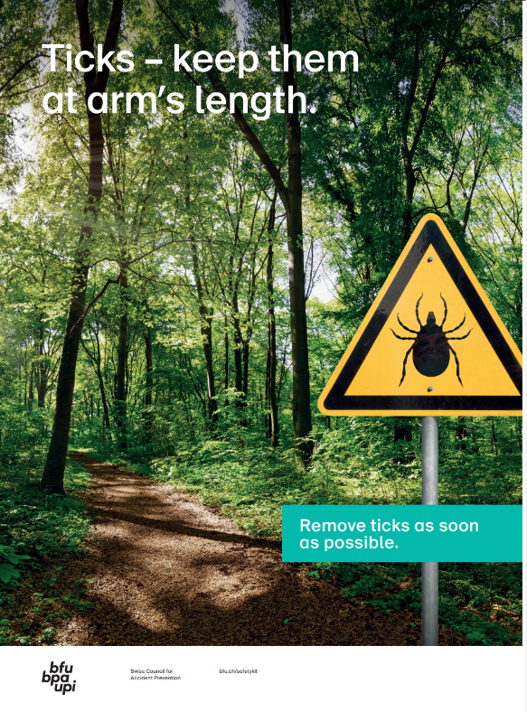
Ticks lurk in the grass, in bushes and at the edge of woodlands and forests.
If you’re unlucky, their bite could make you seriously ill.
So it’s vital to protect yourself properly.

Slide 3
Use tick repellent
Apply tick repellent before going outdoors.
But be aware: this will only offer protection for a limited period of time and is not reliable enough to be used as a sole protective measure.
Ask for advice when you buy.

Slide 4
Wear appropriate clothing
Long sleeves
Long trousers
Socks (→ pull them over the hems of your trousers)
Closed footwear
And: wearing light-coloured clothing makes it easier to spot ticks and remove them before they bite.
Image source: Gettyimages

Slide 5
Check your body for ticks
After spending time outdoors, you should check your entire body for ticks.
Ticks love areas of the body where the skin is thin, warm and moist, for instance on the neck and nape of the neck, on the inner upper arms and legs, in the groin area and on the backs of the knees.

Slide 6
Remove the tick as quickly as possible
The most important thing is to get it out as quickly as possible.
Grip the tick with regular tweezers, tick tweezers or a tick removal card as close to the skin as possible and pull it out without twisting.
Be careful not to crush the tick too much.
Tick remnants in the skin will normally fall out by themselves over time.
Is there any redness or other skin reaction at the site of the bite? Visit a doctor’s surgery without delay!

Slide 7
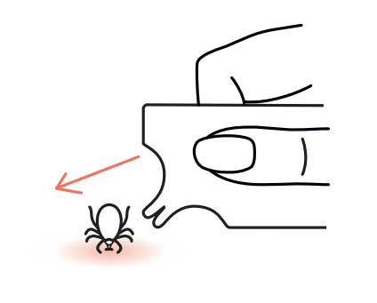
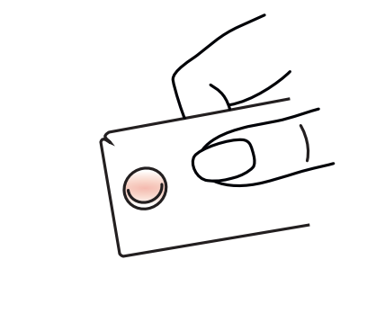
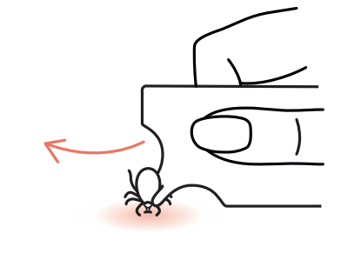
Using a tick removal card
Choose a suitable notch and slide it under the tick.
Now lift the tick removal tool slightly and carefully pull the tick out of the skin.
Use the magnifying glass to check whether the tick has been completely removed.

Slide 8
The tick vaccination offers protection
The tick vaccination protects against tick-borne encephalitis (TBE).
The Federal Office of Public Health (FOPH) recommends the TBE vaccination for all adults and children over the age of six who live or spend time in high-risk regions (the whole of Switzerland except for cantons Geneva and Ticino).
Get advice from a medical professional.

Slide 9
Video Ticks

Slide 10
More information
The Federal Office of Public Health (FOPH) has more information about ticks: Tick-borne diseases (admin.ch)
Find more accident prevention tips at bfu.ch.

