Slide 1
Stay safe, stay on top!
Company, event, date
Name

Slide 2
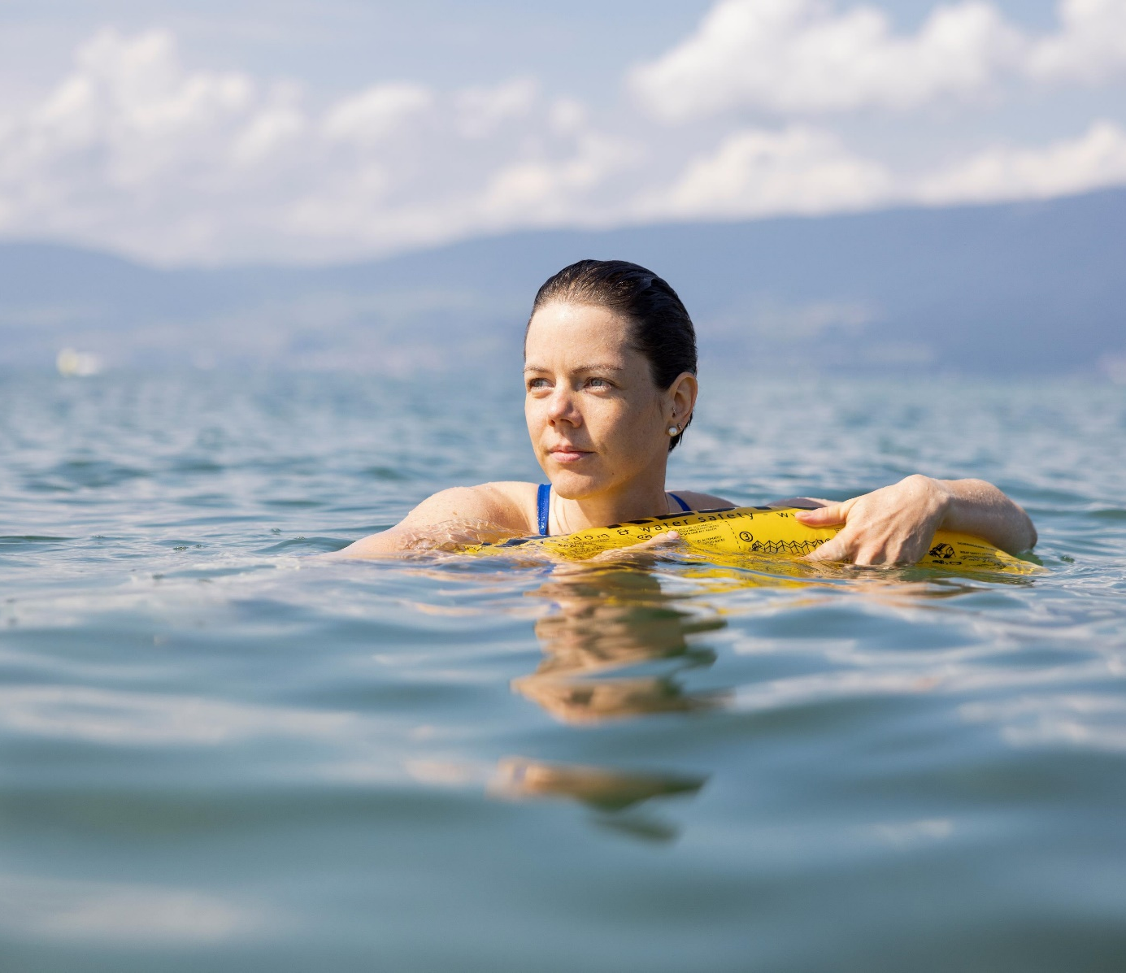
Switzerland is a paradise for water lovers. You can take your pick of countless pools, lakes and rivers for a refreshing dip or an invigorating swim.
Make a splash safely by following these important tips.

Slide 3
Dangers when bathing and swimming
Overconfidence
Insufficient swimming skills
Alcohol consumption
Cold
Currents

Slide 4
Key tips
Use buoyancy aids in open water (e.g. a safety buoy) and never swim alone.

Slide 5
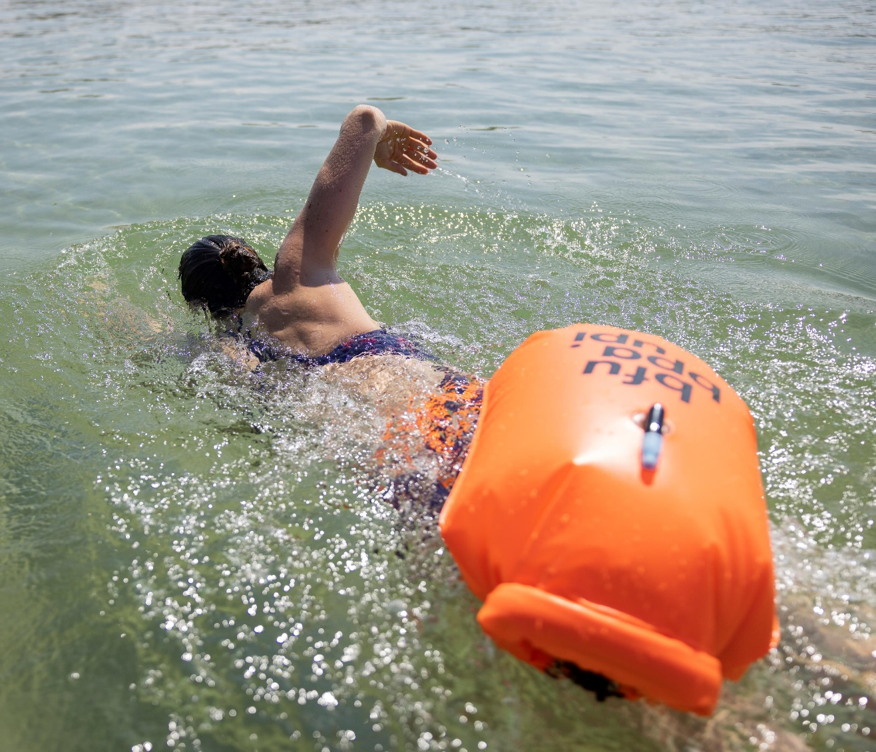
Safety buoy
Safety buoys ensure visibility and can help keep you afloat in an emergency.
Caution: never tie a buoyancy aid to your body when swimming in a river. If the buoy gets caught, you risk being pulled underwater by the current. Exception: river-compatible buoys have a mechanism that detaches the buoy from your body in an emergency.

Slide 6
Key tips
Use buoyancy aids in open water (e.g. a safety buoy) and never swim alone.
Keep a watchful eye on children – and the smallest ones within arm’s reach.

Slide 7
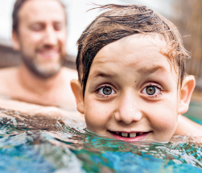
Children in and around the water
Even in shallow water, a small child can drown within seconds. In most cases, this happens silently. This is why children need to be closely supervised by their parents or other carers.
Always keep a close eye on children in and around the water.
Keep the smallest children within arm’s reach – i.e. no more than three steps away.

Slide 8
Key tips
Use buoyancy aids in open water (e.g. a safety buoy) and never swim alone.
Keep a watchful eye on children – and the smallest ones within arm’s reach.
If you don’t feel 100% healthy and fit, only swim in a supervised pool.
Abstain from alcohol and drugs.

Slide 9
Alcohol and drugs
Alcohol and drugs dull the senses. This results in an inability to recognise dangerous situations and a tendency to overestimate one’s own abilities.
That’s why you should never enter the water under the influence of alcohol or drugs!

Slide 10
Key tips
Use buoyancy aids in open water (e.g. a safety buoy) and never swim alone.
Keep a watchful eye on children – and the smallest ones within arm’s reach.
If you don’t feel 100% healthy and fit, only swim in a supervised pool.
Abstain from alcohol and drugs.
Follow the six Swiss Lifesaving Society (SLRG) swimming safety rules.

Slide 11
The six SLRG rules for swimming safety
Only allow children near water under supervision! Keep small children within arm’s reach.
Never enter the water under the influence of alcohol or drugs! Never swim with a full or very empty stomach.
Never jump into the water if you are overheated! Your body needs time to adjust.

Slide 12
The six SLRG rules for swimming safety
Never jump into murky or unfamiliar waters!
The unknown can be dangerous.
Airbeds and swimming aids should not be used in deep water! They offer no protection.
Never swim long distances alone! Even the strongest swimmer can experience dizziness or a fainting spell.

Slide 13
Video “Bathing and Swimming”

Slide 14
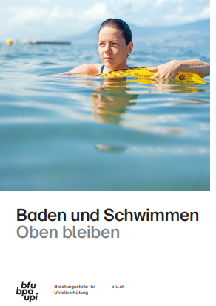
More information
Get more information on the topic in the BFU brochure
“Baden und Schwimmen – Oben bleiben” (Art.-No. 3.009)
It can be ordered free of charge at bestellen.bfu.ch.
Find more accident prevention tips at bfu.ch.

