Slide 1
Run smart and stay the course
Company, event, date
Name last name

Slide 2
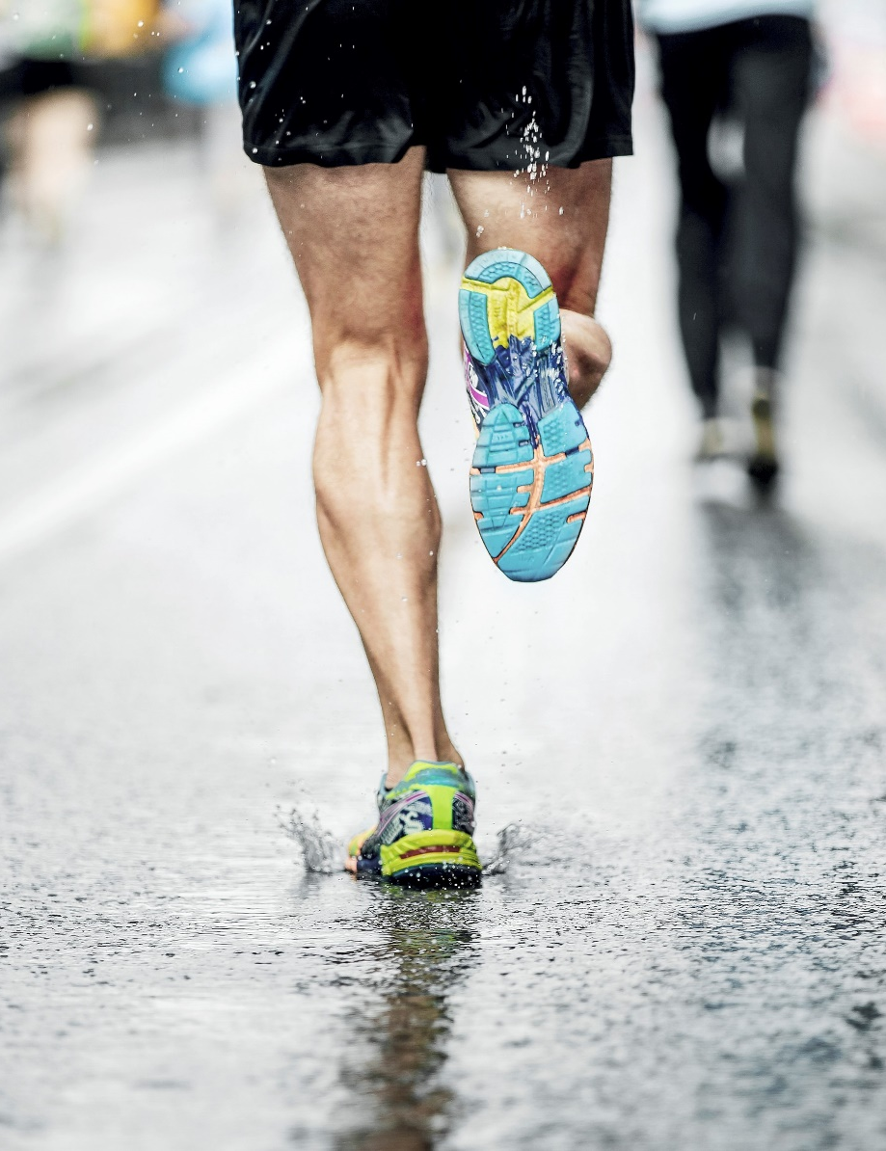
Running is a great mood booster – and a relatively safe one at that. Serious accidents are quite rare. Nevertheless, around 22,000 runners are injured in Switzerland every year.
Image source: Gettyimages

Slide 3
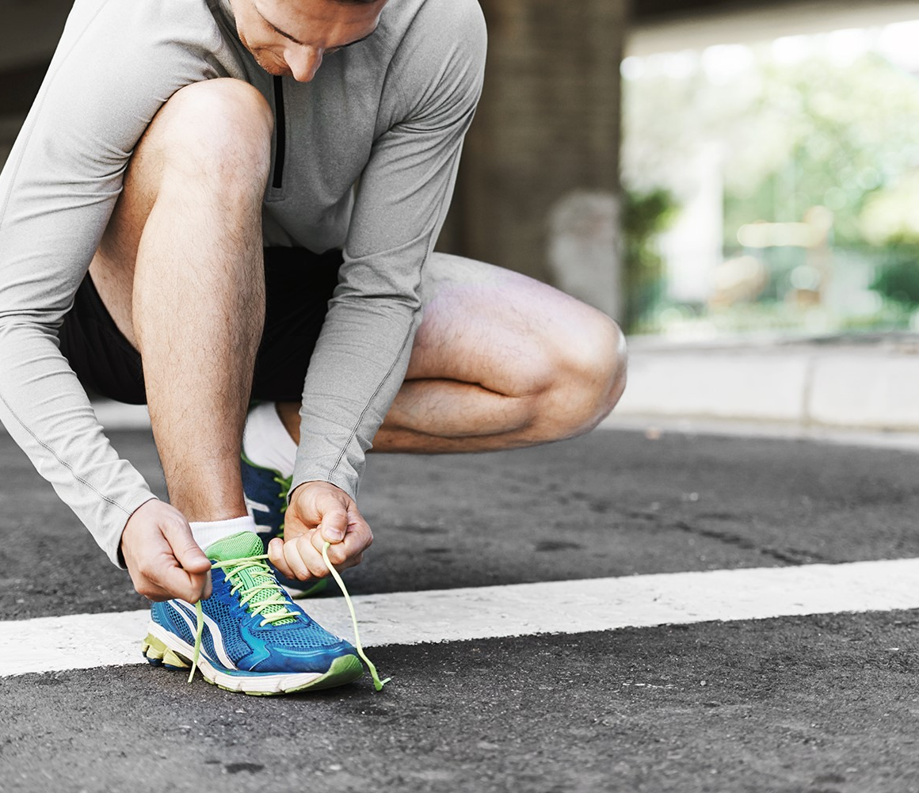
Wear the right footwear
  Buy from a specialist retailer and ask for advice.
  Try on different models.
  Running shoes should have a good tread.
  They should be appropriate for your chosen running surface (tarmac roads, woodland paths etc.).
  Replace your running shoes regularly.
  If you run regularly, you should own more than one pair of running shoes.
Image source: Gettyimages
Notes:
Good tread = shoes not worn out
Replace your running shoes regularly. Signs of excess wear and tear in running shoes:
Sections of the rubber outer sole are so worn that you can see the softer foam underneath.
The midsole feels too soft and collapses easily under pressure.
You may see longitudinal creases in the midsole.
The heel counter becomes mobile and less supportive.
Your toes wear through the toe-box and the shoe upper tears.
One shoe sole becomes asymmetrically worn when compared to the other.
One or both shoes no longer stand up straight when placed on a flat surface.
You feel increased muscle soreness after running.
Source: asics.com
How many pairs of running shoes do you need? One pair for each running session per week, i.e. if you run twice weekly, it is advisable to change shoes.

Slide 4
Hit your stride
  Tips for beginners:
  Plan your training and recovery periods carefully.
  Make sure you adopt a good running technique.
  Start off with short, gentle jogs in flat terrain.
  Alternate between walking and running.
  Choose a pace that allows you to talk to your running partner without getting out of breath.
  Gradually step up frequency, duration and intensity.

Slide 5
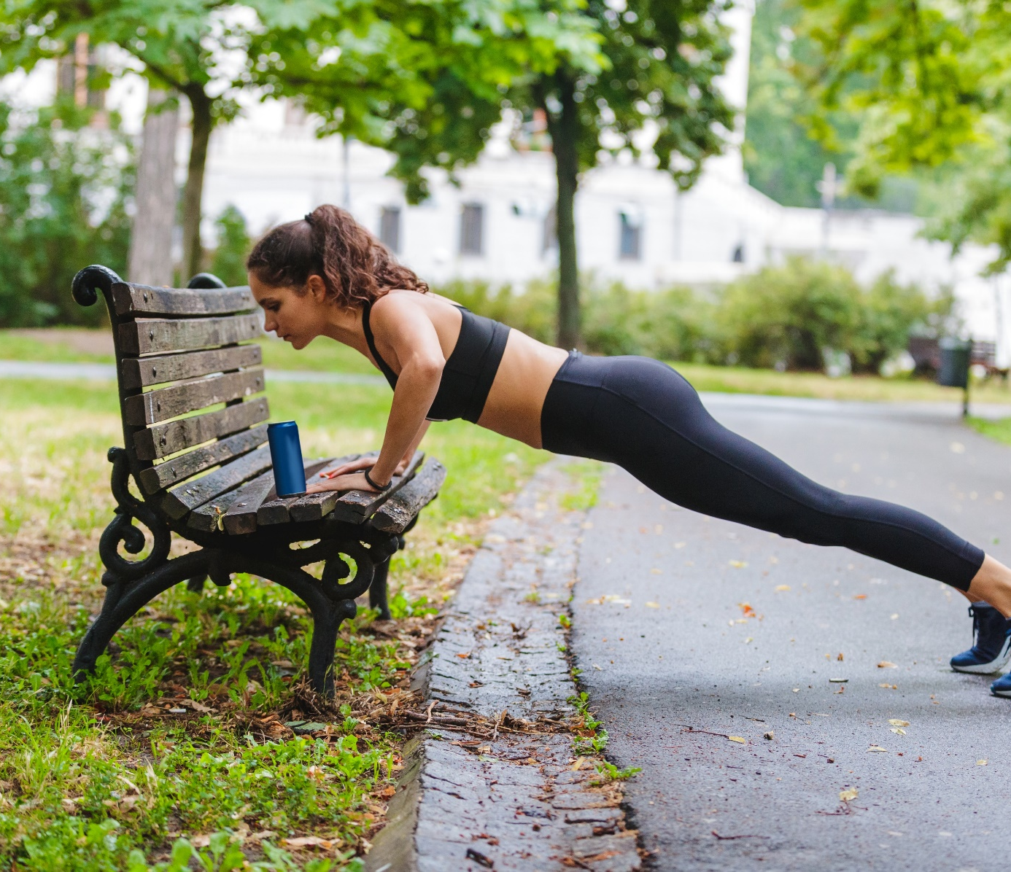
Add strength exercises to your training regimen
To stabilise your foot and knee joints as well as your core, it is important to add strength, mobilisation and stretching exercises to your training regimen – particularly after an injury.
Image source: Gettyimages

Slide 6
Stay focused
  Stay focused; particularly:
    in challenging terrain
    if you are mentally and physically fatigued

Slide 7
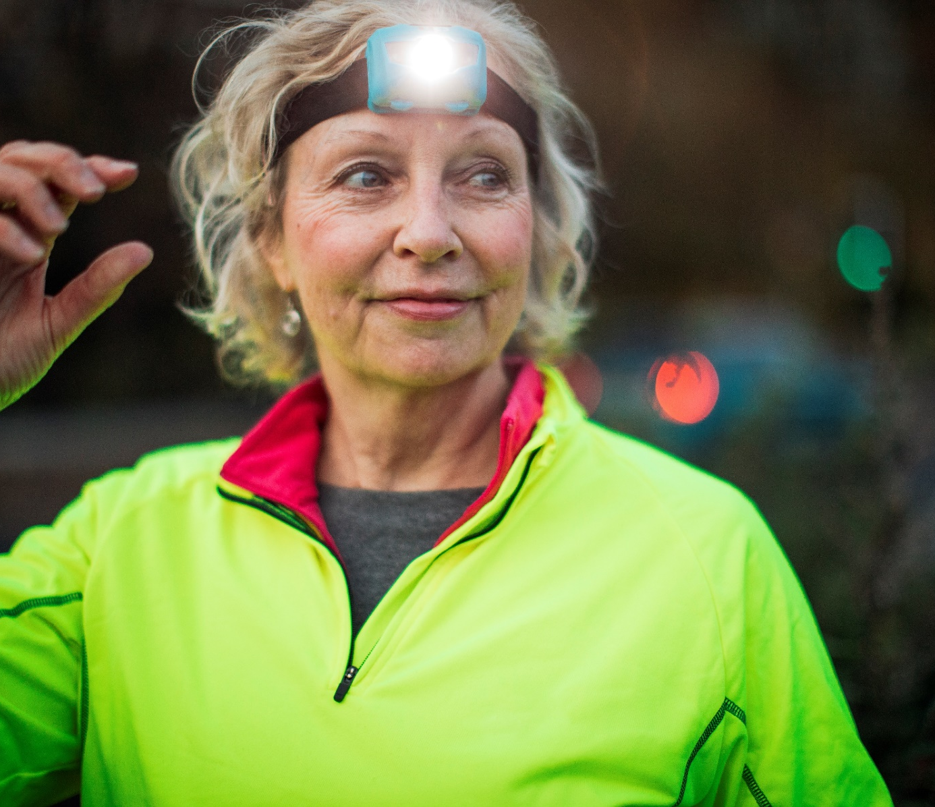
Be visible – in daylight too
  Wear light-coloured clothing.
  Equip yourself with reflective elements that make you visible from all angles (e.g high-visibility vest, fluorescent tapes) and a headlamp if needed.
  Wear reflective accessories especially on moving body parts (arms and legs).
Image source: Gettyimages

Slide 8

Video Accident-free running

Slide 9
More information
Find more accident prevention tips at bfu.ch.

