Slide 1
It’s time for a 15-minute power nap
Company, Event, Date
Name

Slide 2
Non-occupational accidents in Switzerland, 2018
Every year, more than one million people are injured on the roads, when doing sport and physical activities as well as in and around the house.

Slide 3
Drowsiness at the wheel
Around 10 % of serious accidents are caused by overtired drivers.
Not only is nodding off at the wheel – known as microsleeping – dangerous, even the preceding drowsiness and impaired performance can lead to serious accidents.

Slide 4
What causes drowsiness at the wheel?
Too little sleep or a sleep deficiency lasting days or weeks
Driving at night or in the early morning hours when you would normally be sleeping
Long waking periods (e.g. after going out in the evening)
Too long journeys without rest breaks
Irregular sleep patterns (e.g. from shift work)
Illnesses that can impair sleep and cause daytime drowsiness: sleep apnea (interrupted breathing during sleep) or depression

Slide 5
The effects of driving while drowsy
Drowsy drivers:
misjudge speed,
have poor concentration,
react similarly slowly as after drinking alcohol,
can nod off in a worst-case scenario (so-called microsleep)

Slide 6
Look out for the alarm signals:
Burning eyes
Heavy eyelids
Frequent yawning
Blurred vision
Dry mouth
Being startled for no apparent reason
Chills
Driving errors

Slide 7
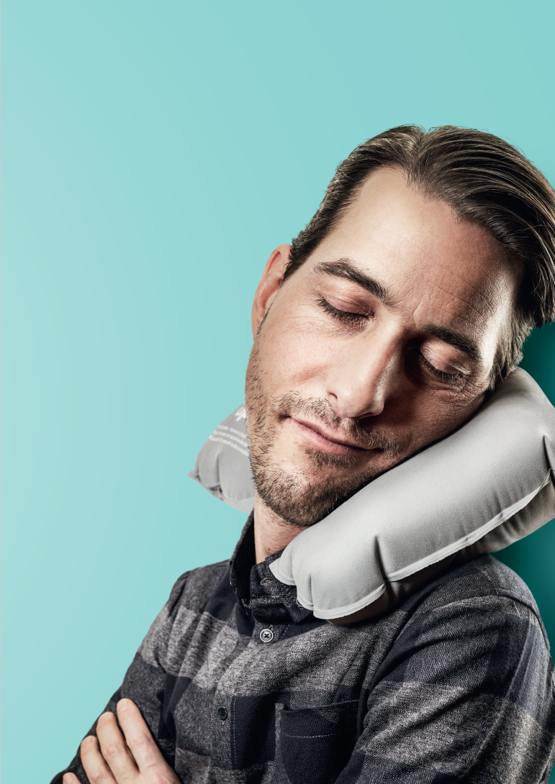
If you start to feel drowsy while driving:
Stop at the next opportunity and take a 15-minute power nap. Make sure you don’t sleep for longer than 30 minutes; waking up after half an hour is difficult. In addition to a power nap, two cups of coffee can provide fast, short-term help against fatigue. Drink it before you fall asleep. The effect kicks in after around 15 minutes. Don’t forget: engine off, remove keys from ignition!

Slide 8
How to get there safely:
Only drive if you are well-rested and healthy.
See a doctor if you suffer from sleep apnea or any another sleeping disorder.
Do not drive if you know in advance that it’s going to be a late night. Make alternative sleeping arrangements or plan to get home by public transport or taxi.

Slide 9
How to get there safely:
Alcohol exacerbates fatigue. It’s best to go without.
Medications may also impact your ability to drive – especially in combination with alcohol.
Be aware: Tricks such as opening a window or turning up the music are virtually ineffective against drowsiness at the wheel.

Slide 10
True or false?
I make more errors when I’m tired.
True ☑ False □
Alcohol causes drowsiness.
True ☑ False □
Coffee or energy drinks can be used to permanently overcome fatigue.
True □ False ☑
Listening to the radio on loud or opening a window help against over-tiredness.
True □ False ☑
A power nap is the only effective measure against drowsiness at the wheel.
True ☑ False □
Notes:
Caffeine can boost alertness, but only has a short-term effect
Tricks such as opening a window or turning up the music are virtually ineffective

Slide 11
Video «Drowsiness at the wheel»

Slide 12
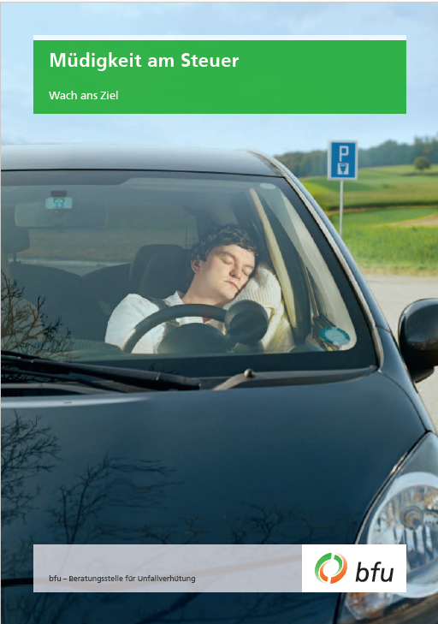
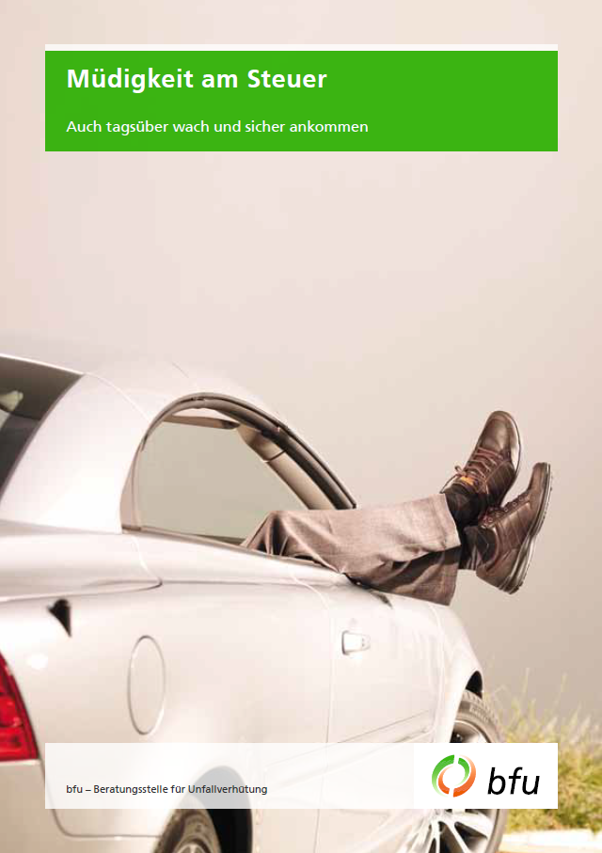
Further information
Find out more on this topic in our free BFU brochures (available in French, German and Italian):
«Müdigkeit am Steuer – Wach ans Ziel» (Art.-Nr. 3.013)
«Müdigkeit am Steuer – Auch tagsüber wach und sicher ankommen» (Art.-Nr. 3.133)
Order at bestellen.bfu.ch
Find even more accident prevention tips at bfu.ch.

