Slide 1
Be smart – don’t use your phone.
Company, event, date
Name

Slide 2
Accidents in road traffic, 2023
21 500 casualties
Of which 4096 seriously injured
236 fatalities
Source: Police-registered road traffic accidents, BFU Status 2024

Slide 3
Police-recorded causes
Seriously injured and fatalities, 2023
Potential cause | Number | In %*
Inattentiveness/distraction | 1361 | 31 %
Disregarding right of way | 979 | 23 %
Speed | 890 | 21 %
Alcohol | 537 | 12 %
Vehicle operation | 354 | 8 %
Influence of narcotics/medicines | 178 | 4 %
Source: BFU Sinus 2024
* Share of overall seriously injured and fatalities

Slide 4
Accident risk
Mobile phone use in general increases the accident risk by a factor of 3.6.
The manual use of mobile phones is particularly dangerous:
Writing text messages increases the accident risk by a factor of 6.1.
Operating electronic devices (sat nav, radio etc.) increases the accident risk by a factor of 2.5.
Talking to passengers increases the accident risk by a factor of 1.4.
Reaching for items – e.g. on the back seat of the car – increases the accident risk by a factor of 9.1.
Source: Dingus et al., 2016

Slide 5
Reaction times
An undistracted driver will normally react within 2 seconds.
If the driver is distracted, the reaction time is approximately one third longer. Consequently, this results in a longer braking distance.

Slide 6
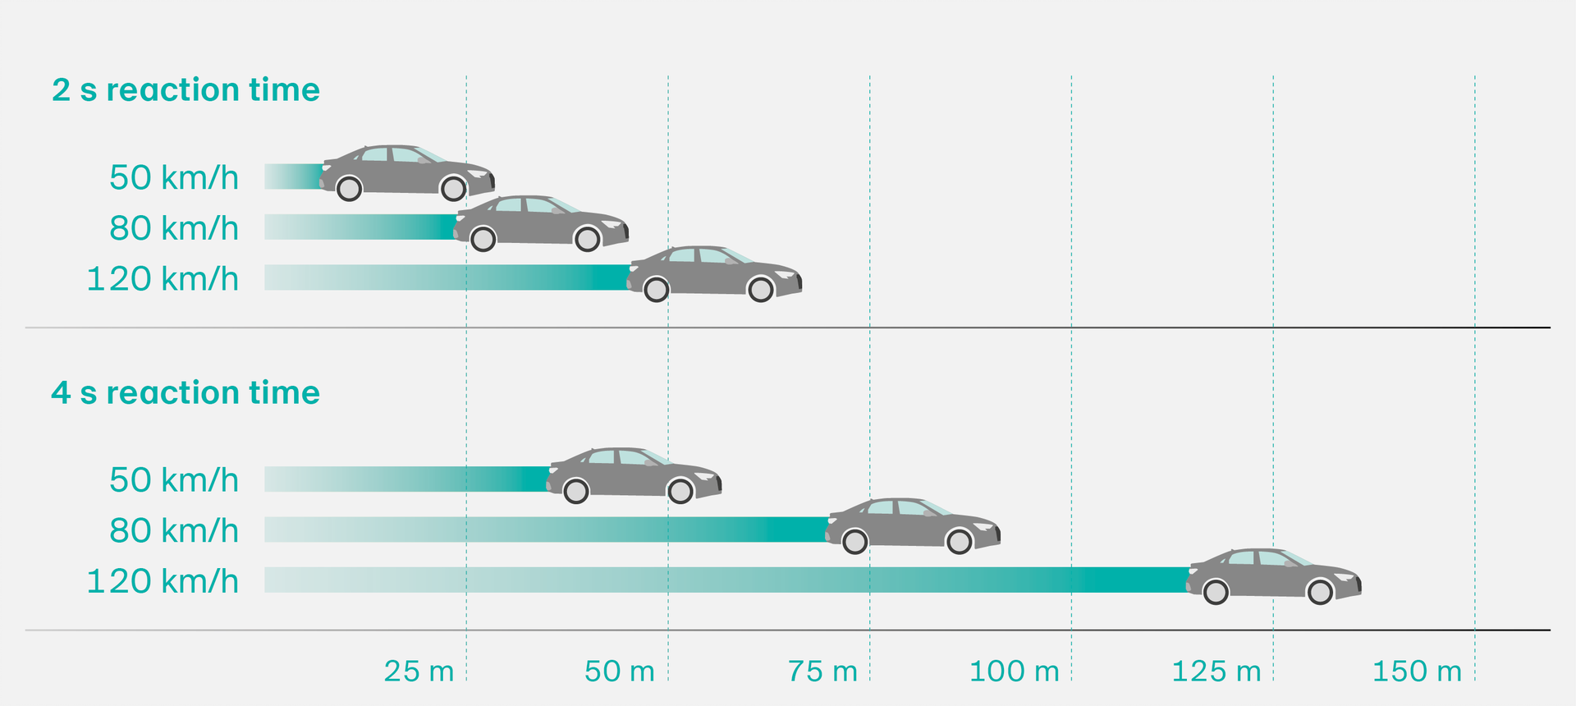
Reaction times
With a reaction time of three seconds, motorists will cover a distance of 100 metres on the motorway before even being able to act – this is equivalent to the length of a football pitch.

Slide 7
Potential legal consequences
Driving while phoning without a hands-free set incurs a fine of CHF 100.
Driving while phoning without a hands-free set – if this causes an accident – has led to reduced insurance payouts due to gross negligence.
Phoning with a hands-free set while driving and writing text messages while driving may lead to a conviction for violating traffic rules, in particular if the driver can no longer fulfil his or her duty of care, i.e. is no longer in control of the vehicle.

Slide 8
Getting there safely
Before you set off:
Activate airplane mode on your smartphone
Programme your destination into your sat nav device
Select a music playlist

Slide 9
Getting there safely
During the journey:
Keep your attention on the traffic. Avoid activities that might distract you.
Don’t search or reach for items inside the car.
Calls are distracting – whether with or without a hands-free set. This is why you should only make or take phone calls while your vehicle is stationary and away from traffic.
Don’t read or write text messages.
→ Park in a safe place if you need to attend to something that cannot wait.

Slide 10
Video «Be smart – don’t use your phone.»

Slide 11
More information
Find more accident prevention tips at bfu.ch.

