Slide 1
Control your bike and stay in the saddle.
Company, Event, Date
Name

Slide 2
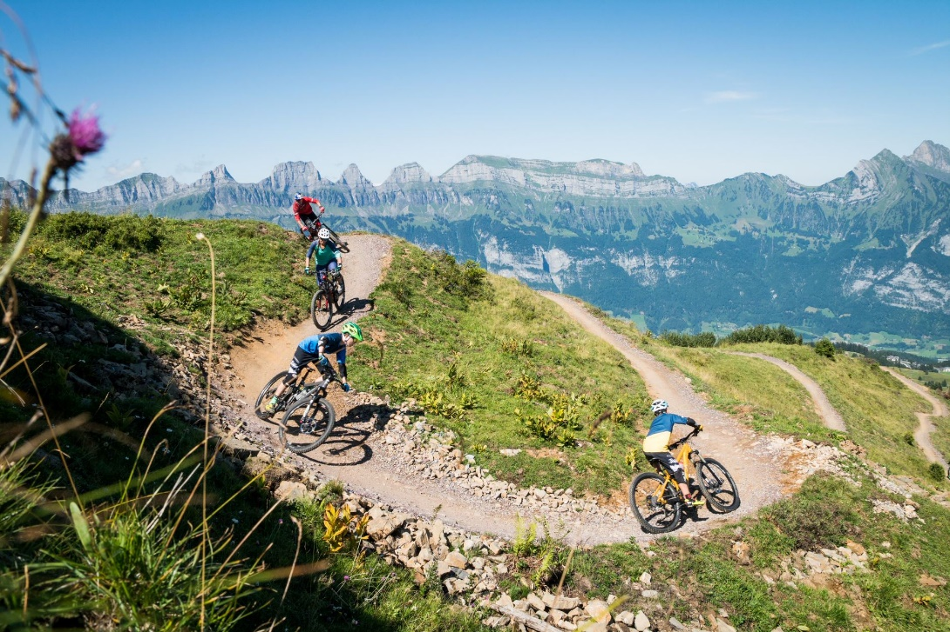
Mountain biking
Enjoy the fresh air, get plenty of exercise and feel the breeze in your face: mountain biking is the perfect combination of physical activity and the great outdoors.
But it’s not always an easy ride – every year, over 11 000 people in Switzerland suffer an accident while mountain biking off road.
® Urban Engel, Bergbahnen Flumserberg AG

Slide 3
The right preparation

Slide 4
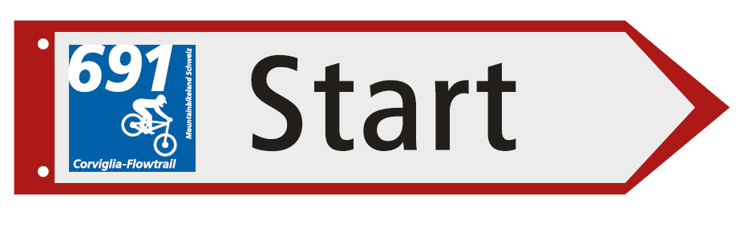
Preparation is key
  Choose a route that suits your technical skills and physical ability.
  For downhill mountain biking, choose a destination with well-maintained bike pistes and mountain biking parks with clearly indicated difficulty levels.
  Maps, tour guides and GPS tour recommendations: mountainbikeland.ch

Slide 5
The right equipment

Slide 6
Protect yourself with the right equipment
  Bicycle helmet (EN 1078)
  Sports goggles
  Long-fingered gloves
  Protectors (activity dependent, e.g. for trail biking)
  Functional and weather-proof clothing
  Bike shoes with good treads for walking sections
  Food and drink
  Repair kit
  First-aid kit
  Well audible bell or trail bell
  Mobile phone with emergency app, GPS, maps
  Backpack

Slide 7
Protect yourself with the right equipment
  Get specialist advice when buying a bike to ensure that your chosen model is suited to your riding ability and the intended use.
  Have your mountain bike regularly checked and serviced by a specialist.
  Check your bike before every ride.

Slide 8
Protect yourself with the right equipment
On public roads, the Road Traffic Act regulations also apply to mountain bikes:
  Lights: steady (non-flashing) lights; white at the front, red at the rear
  Reflectors: permanently attached; white at the front, red at the rear
  Pedal reflectors: front and rear – except on racing pedals, safety pedals and similar
  Brakes: on front and rear wheels
  Tyres: the fabric should not be visible
  → Make sure your mountain bike is appropriately equipped and wear reflective clothing/clothing with reflective elements.

Slide 9
Ride safely

Slide 10
Set a good example
  Expect the unexpected – think ahead and ride focused and at a speed that is adapted to the prevailing conditions.
  Unsure on difficult or exposed trail sections? Dismount in good time and push your bike.
  Ride downhill in a defensive manner – for E-MTB riders, this also applies to riding uphill.
  Avoid busy hiking trails and alert hikers to your presence in good time (e.g. with a bell).

Slide 11
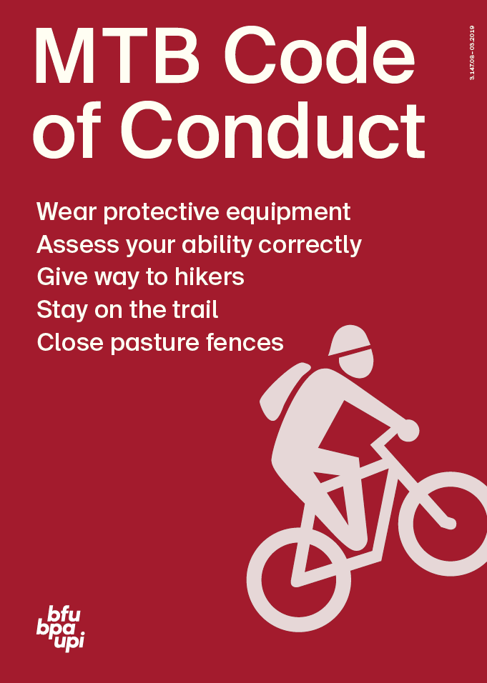
Observe the MTB Code of Conduct

Slide 12
Electric mountain biking

Slide 13
E-mountain biking
  The same recommendations apply as for mountain biking without a motor.
  E-mountain bikes are heavier and have a motor – familiarise yourself with the handling of your e-mountain bike in an off-road environment.

Slide 14

Video «Mountain biking»

Slide 15
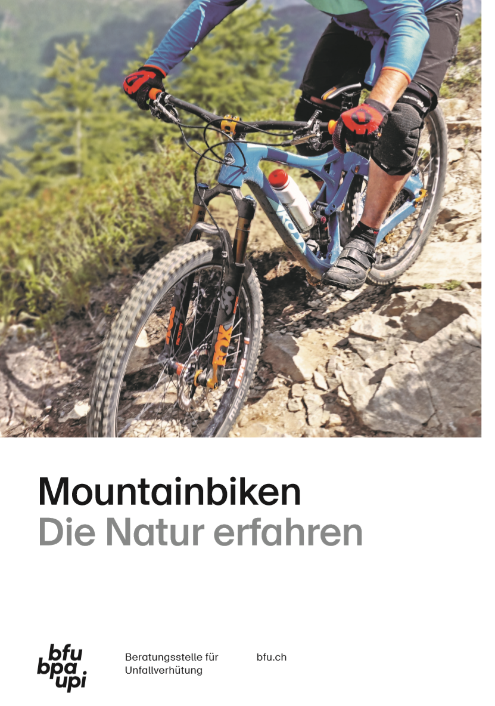
More information
Find out more on this topic in the BFU brochures
(available in French, German and Italian):
«Mountainbiken – Die Natur erfahren» (Art.-No. 3.020)
«Kluge Köpfe schützen sich – Den Velohelm richtig anziehen» (Art.-No. 3.112)
Order them free of charge at bestellen.bfu.ch.
Find even more accident prevention tips at bfu.ch.

