Slide 1
Hands off broken glass
Company, Event, Date
Name

Slide 2
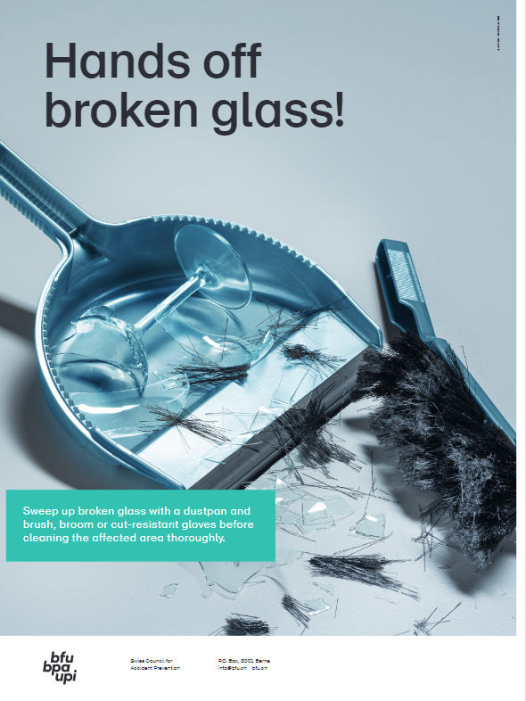
On glass shards or the jagged edge of a can lid, while peeling vegetables or slicing cheese – cuts can happen in the blink of an eye.
Many of these accidents occur through wrong or careless handling of blades, broken glass or metal.

Slide 3
Dispose of shards the right way
Immediately clean up any glass shards with a dustpan and brush, broom or cut-resistant gloves.
Clean the surrounding area with a damp household cloth and dispose of the cloth.

Slide 4
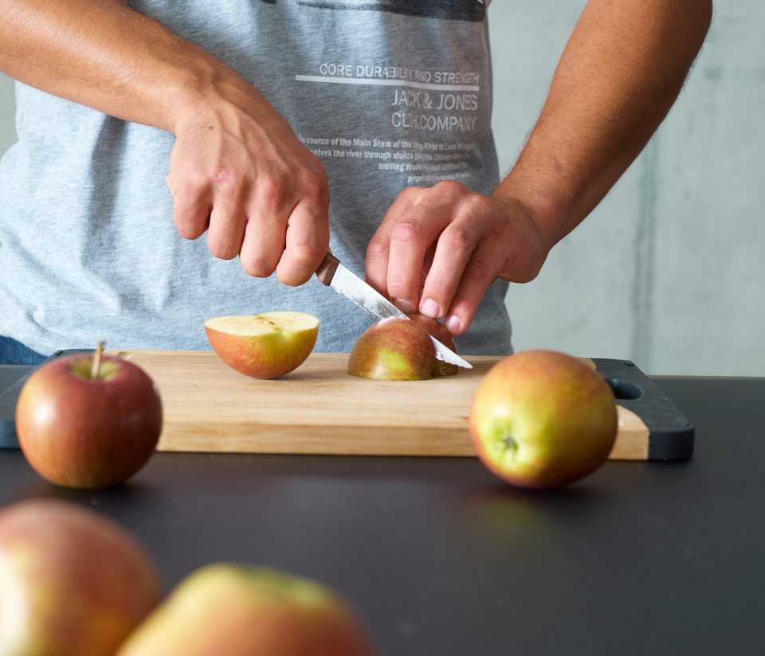
How to cut safely
Always guide the knife with the blade facing away from and never towards your body.
Use a non-slip cutting board.
Don’t leave sharp objects lying around.

Slide 5
Open cans the right way
Use a safety can opener. These handy gadgets open cans without leaving sharp edges.

Slide 6
Video

Slide 7
Further information
More on this in the BFU’s «Checkliste für ein sicheres Zuhause» brochure (Art. no. 3.026). Available only in German, French and Italian .
Order it free of charge at bestellen.bfu.ch.
Find more accident prevention tips at bfu.ch.

