Slide 1
DIY the smart way
Company, event, date
Name

Slide 2
Common accident causes
Lack of experience
Lack of knowledge in the use of machines and appliances
Inappropriate use of appliances
Time pressure

Slide 3
Video

Slide 4
General safety tips
Factor in sufficient time and make sure you are well prepared.
Read the instruction manual before using an appliance/ equipment and be aware of the possible risks.
Check equipment for safety before use: are the cable and plugs intact? Are your tools properly sharpened and clean?
Do not remove the safety catches/devices.

Slide 5
General safety tips
Wear the appropriate protective equipment depending on the work and appliance used.
Do not wear loose clothing, scarves or jewellery. Do wear sturdy, suitable footwear.
Tie long hair back.

Slide 6
General safety tips
Make sure the appliance is switched off before you connect it to the mains power source or battery.
Make sure that the cables are routed in such a way that they cannot be tripped over.
Do not put the appliance down until the moving parts have stopped rotating completely.
Remove the plug from the power socket if work has been interrupted or the appliance is being cleaned.
Remove the spark-plug from internal combustion engines.

Slide 7
General safety tips
Keep your work area clean and pay attention to good lighting.
Use a suitable surface when drilling, sawing and grinding. It must be completely stable.
Make sure you are standing firmly and maintain balance at all times.
Keep children and other people away from running electrical appliances or make sure they wear the appropriate protective equipment.

Slide 8
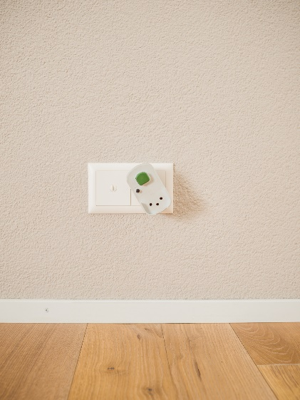
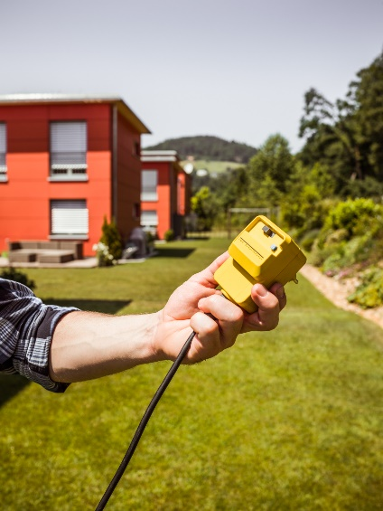
Residual current circuit breaker (RCD)
Make sure that the power socket is protected by a residual current circuit breaker (RCD), particularly when working outdoors.
Check the RCD regularly to ensure that it is working properly.
Check the electrical cable for defects and route it in a manner that prevents it from being damaged.

Slide 9
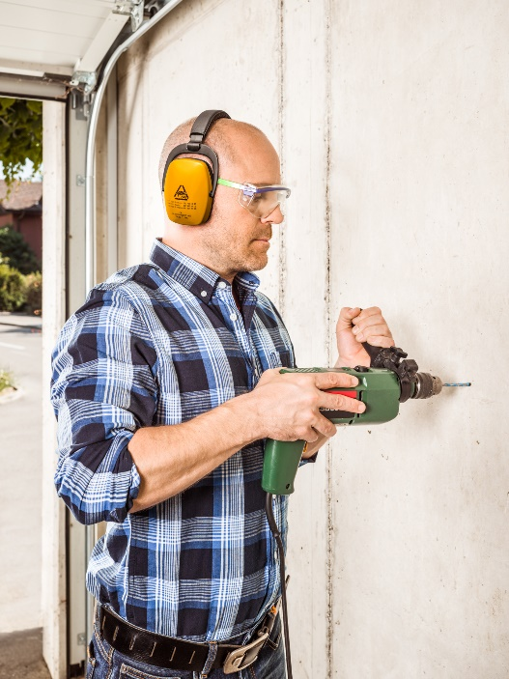
Hand-held drill
Wear ear defenders and safety glasses; closed safety glasses if drilling overhead.
Use the auxiliary handle (usually supplied).
Do not drill at eye level.
Remove the chuck key.
Secure the work piece.
Do not work on metallic materials with a fitted suction device (fire hazard).

Slide 10
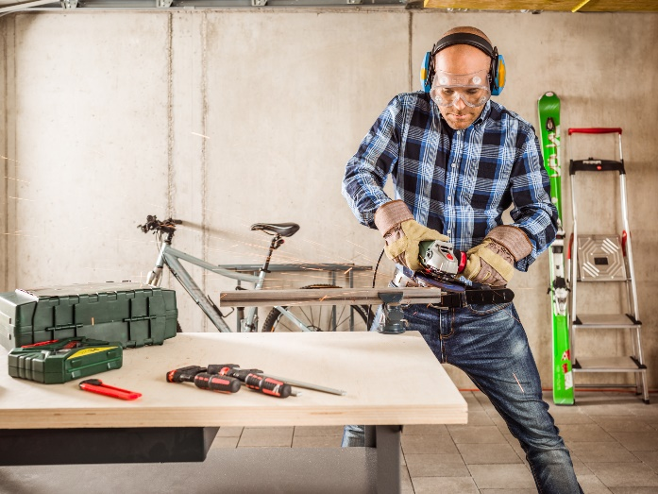
Angle grinder (flex)
Wear closed safety glasses, ear defenders, protective gloves and, where appropriate, a dust mask.
Cover your arms.
Only used manufacturer-approved accessories.
Hold the angle grinder firmly in both hands.

Slide 11
Angle grinder (flex)
Clamp the work piece securely.
Don’t let your power tool run while you are carrying it around.
Pay attention to the direction of flying sparks (fire hazard).
Pay attention to the expiry date stamped on the discs (details at the centre of the disc).

Slide 12
Jigsaw / Hand saw
Wear safety glasses and ear defenders.
Clamp the work piece securely.
Switch the jigsaw on before applying it to the work piece.
Keep your hands away from the sawing area. Do not reach beneath the work piece.
Guide the jigsaw with both hands.
Do not remove the jigsaw from the work piece until it has stopped moving.

Slide 13
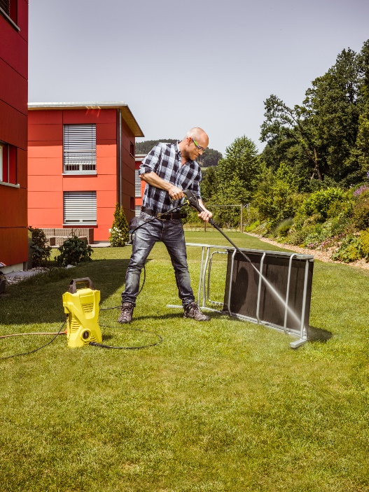
High-pressure cleaner
Wear protective glasses, gloves and long trousers.
Never point the appliance at people, animals or electrical devices.
Connect the appliance only to sockets equipped with a residual current circuit breaker (RCD).
Make sure that the high-pressure hose is not damaged (risk of bursting).

Slide 14
High-pressure cleaner
Never suction solvent-containing fluids, undiluted acids and solvents.
Do not clamp the trigger lever of the power washing nozzle during operation.
Keep a distance of at least 30 cm between the nozzle and the surface being cleaned.
Never leave the appliance unattended while the machine is running.
Remove the spray lance if you leave the appliance unattended.

Slide 15
Further information
More on this in the BFU’s «Checkliste für ein sicheres Zuhause» brochure (Art. no. 3.026). Available only in German, French and Italian .
Order it free of charge at bestellen.bfu.ch.
Find more accident prevention tips at bfu.ch.

