Slide 1
Reflect and make sure you stand out.
Company, Event, Date
Name

Slide 2
On foot and on a bicycle, the accident risk doubles in the dark.

Slide 3
Video «Be visible»

Slide 4
Be visible when out and about – on foot and while jogging
Choose clothing that is as light-coloured as possible.
Equip yourself with reflective materials that are visible from all angles.
Wear reflective accessories, in particular on moving body parts (legs, arms), since they are constantly in motion.

Slide 5
Be visible when out and about – on a bicycle or an e-bike
Equip your bicycle or e-bike with regulation-compliant lights.
Add spoke reflectors or reflective tyres.
Wear reflective clothing or accessories.
Switch on the lights at dusk and also in rain and fog – preferably already during the day.

Slide 6
Be visible when out and about – while driving
Remove snow and ice from the windscreen and rear windows in winter.
Make sure your headlights are always clear too.
Adapt your driving style to the visibility and weather conditions.

Slide 7
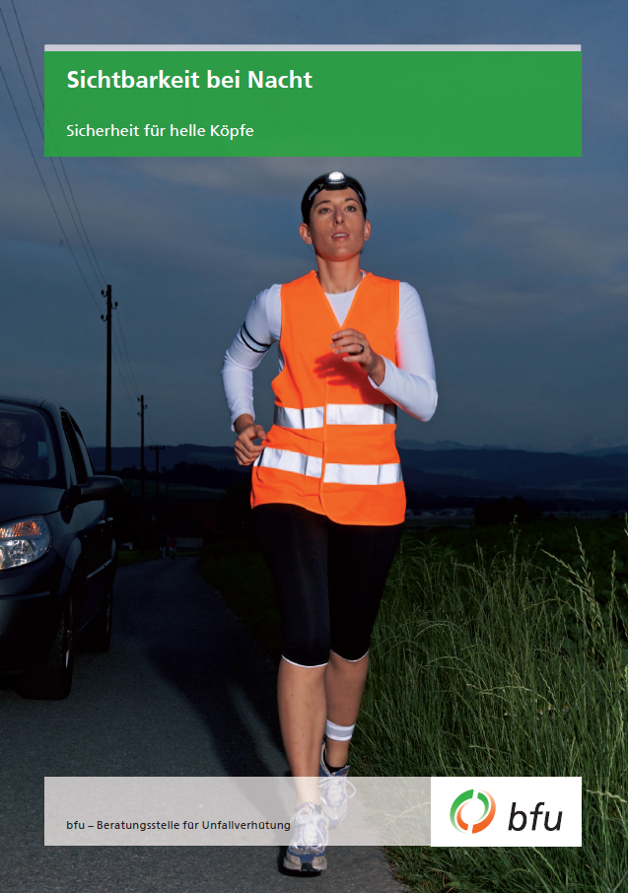
More information
Get more information on this topic in the BFU brochure «Sichtbarkeit bei Nacht» (Art.-No. 3.008).
Order or download it free of charge at bestellen.bfu.ch.
Find more accident prevention tips at bfu.ch.

