Slide 1
Slow down – stay safe
Company, event, date
Name

Slide 2
Non-occupational accidents in Switzerland, 2018
Every year, more than one million people are injured on the roads, when doing sport and physical activities as well as in and around the home.

Slide 3
Persons injured, by type of sport (Ø 2014–2018)
Type of sport Persons injured
Ball games 136 000
Winter sports 89 000
Skiing 52 000
Snowboarding 10 000
Cycling and skating (not in traffic) 34 000
Gymnastics, athletics 34 000
Mountain sports, hiking 33 000
Water sports 19 000
Other types of sports 78 000 Total: 424 000
Notes:
Persons injured in other sports (Ø 2014-2018):
Tobogganing 6290
Ice-hockey 4960
Cross-country skiing 5850
Ice-skating, figure skating 3790
Back-country skiing 950
Other winter sports 5290
Other types of sports include martial arts, bowling, throwing and hitting games, equestrian sports, dancing, motor vehicle racing

Slide 4
Over 90 % of all skiing and snowboarding accidents are self-induced.
This is why you should think ahead on the slopes, be pro-active and pay attention to the BFU tips.

Slide 5
Adapt your speed
Skiers and snowboarders are often travelling faster than they think and can quickly reach a speed of 50 km/h.
A collision with a stationary obstacle at this speed is comparable to a fall from 10 metres height.
→ Adapt your speed to your ability and the prevailing slope conditions – this massively reduces your risk of suffering an accident.

Slide 6
Do your pre-season prep
Strengthen your trunk and leg muscles with balance- and strength-training exercises.
Take a course – improve your technique under the supervision of a qualified snowsports instructor.

Slide 7
Be properly equipped – Skiing
Check your skis regularly and keep them properly maintained.
Have your ski bindings adjusted every year by a specialist retailer and checked with a testing device.
skivignette.bfu.ch

Slide 8
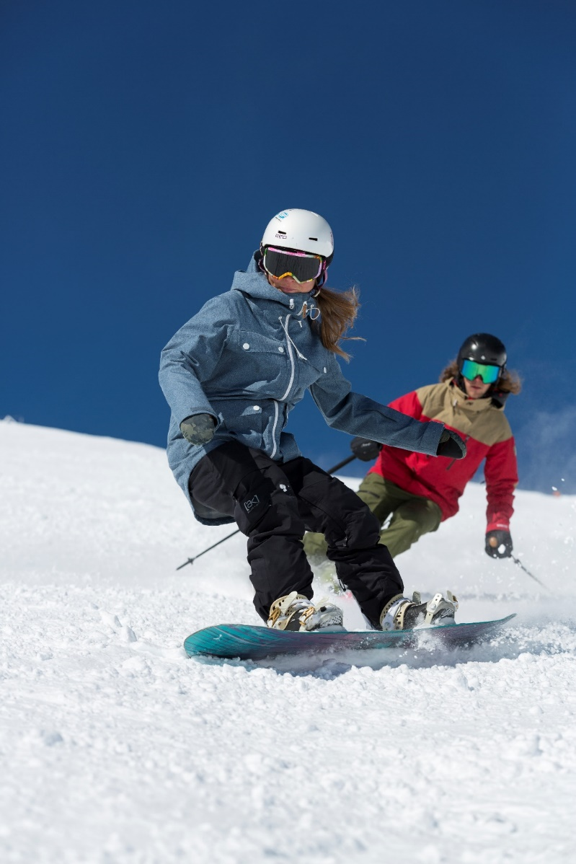
Be properly equipped – Snowboarding
Check your snowboard regularly and keep it properly maintained.
Tighten the screws on your snowboard binding and replace defective parts.

Slide 9
Be properly equipped – Clothing and protective gear
Wear warm, weather-proof clothing.
Wear a snowsports helmet – every sixth accident results in head trauma.
Novice snowboarders in particular should also wear wrist protectors.
A back guard gives added protection, especially in snow parks.
Don’t forget your contact lenses or prescription glasses.
Wear snow goggles/sunglasses with adequate protection against UV rays.

Slide 10
Act responsibly – the 10 FIS and 3 SKUS rules of conduct
Personal responsibility takes top priority on the slopes. The International Ski Federation FIS has issued 10 binding rules of conduct for snowboarding and skiing:
Do not behave in a way that endangers or harms anyone.
Be alert and in control. Adapt your speed and manner of skiing to your personal ability and the prevailing terrain conditions.
When coming from behind, choose a route that does not endanger skiers or snowboarders ahead.
Leave ample space when overtaking.

Slide 11
Act responsibly – the 10 FIS and 3 SKUS rules of conduct
5. Look up and down the slope before entering a marked run, starting again or moving upwards.
6. Only stop at the edge of the slope or where you can be easily seen.
7. Keep to the edge of the slope when climbing or descending on foot.
8. Respect all signs and markings.
9. In the event of an accident: provide assistance, alert the rescue services.
10. Involved parties and witnesses must provide their names and addresses.

Slide 12
Act responsibly – the 10 FIS and 3 SKUS rules of conduct
Snowboarders: the Swiss Commission for the Prevention of Accidents on Snowsports runs SKUS has issued 3 additional rules:
1. Place your snowboard upside down (binding facing downwards) in the snow.
2. Remove your back leg from the binding when using ski- or chairlifts.
3. With alpine-style bindings, attach your front leg firmly to the board with a safety leash.

Slide 13
Video «Sicher die Piste hinunter.»

Slide 14
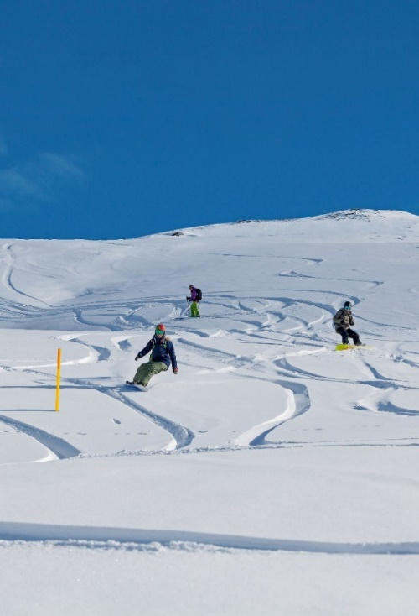
Freeriding: Safety first off-piste
The top tips
Deep-snow skiing: use the secured, yellow-marked downhill runs.
Take basic and advanced training courses in avalanche awareness.
Abstain from freeriding when the avalanche risk on the five-level scale is 3 (considerable) or above.

Slide 15
Freeriding: Safety first off-piste (2)
The top tips
Inexperienced? Join a tour led by someone well-versed in avalanche safety.
Carry a charged mobile phone and emergency equipment: an avalanche transceiver (rescue beacon), a probe and shovel

Slide 16
Video «Freeriden: Mehr Sicherheit beim Tiefschneefahren»

Slide 17
More information
Find more accident prevention tips at bfu.ch.

