Slide 1
Mountain hiking isn’t a walk in the park.
Company, Event, Date
Name

Slide 2
Switzerland has around
20 000 km
of signposted and maintained mountain hiking trails.
40
Swiss hikers die every year while mountain hiking.
4000
suffer a serious injury (Swiss resident population).

Slide 3
Be well prepared
  Use maps, hiking guidebooks and/or websites to thoroughly plan your route, time requirements and reserves and possible alternative routes/detours.
  Take into account the specific demands (trail category, gradient, exposed sections), trail conditions (e.g. residual snowfields in early summer) and weather.
  Realistically assess your own physical constitution and capabilities (or those of the weakest member of the group) and plan accordingly.

Slide 4
The key physical requirements
  Fitness
  Surefootedness
  A head for heights
  → Are you ready to take on a white-red-white trail? Find out by taking the test (available in German, French and Italian):
  https://sicher-bergwandern.ch/de/selbsttest
Notes:
F: https://rando-en-montagne.ch/fr/test
I: https://trekking-sicuro.ch/it/autovalutazione

Slide 5
Be well prepared
  Do not set out on an unfamiliar, challenging tour on your own. If you are hiking alone, choose an easier, less remote route.
  Inform someone else about your hike, especially if you intend to set out on your own.
  → Find a mountain hike planning checklist at sicher-bergwandern.ch (available in German, French and Italian).
  → Find recommendations for hikes at wandern.ch, schweizmobil.ch and myswitzerland.com.

Slide 6
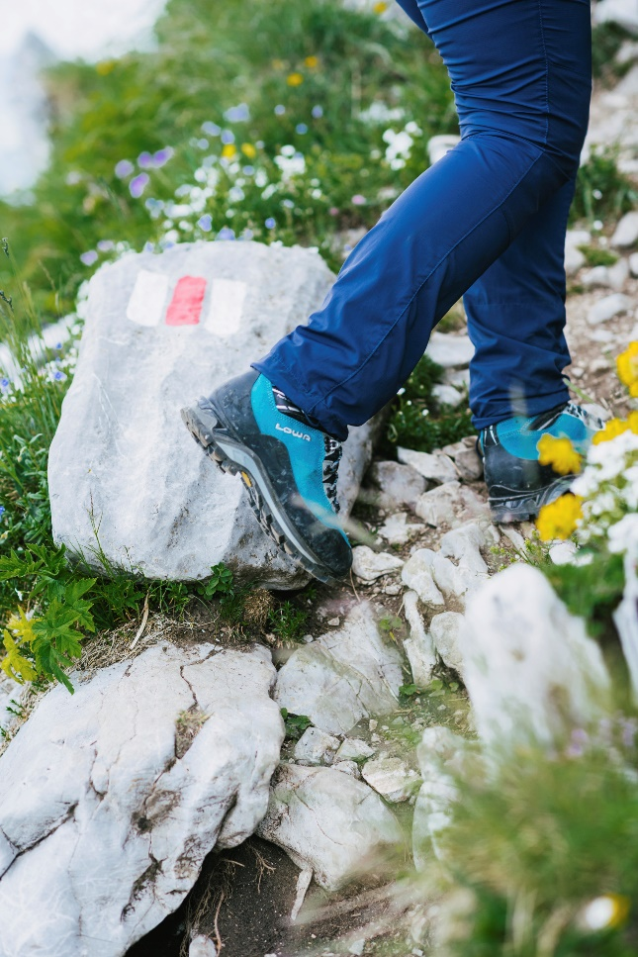
Rule of thumb for calculating hiking time (without breaks)
Ascent:
Allow 15 minutes per 100 metres elevation gain,
plus 15 minutes per kilometre covered on flat terrain.
Descent:
Allow 15 minutes per 200 metres elevation loss,
plus 15 minutes per kilometre covered on flat terrain.

Slide 7
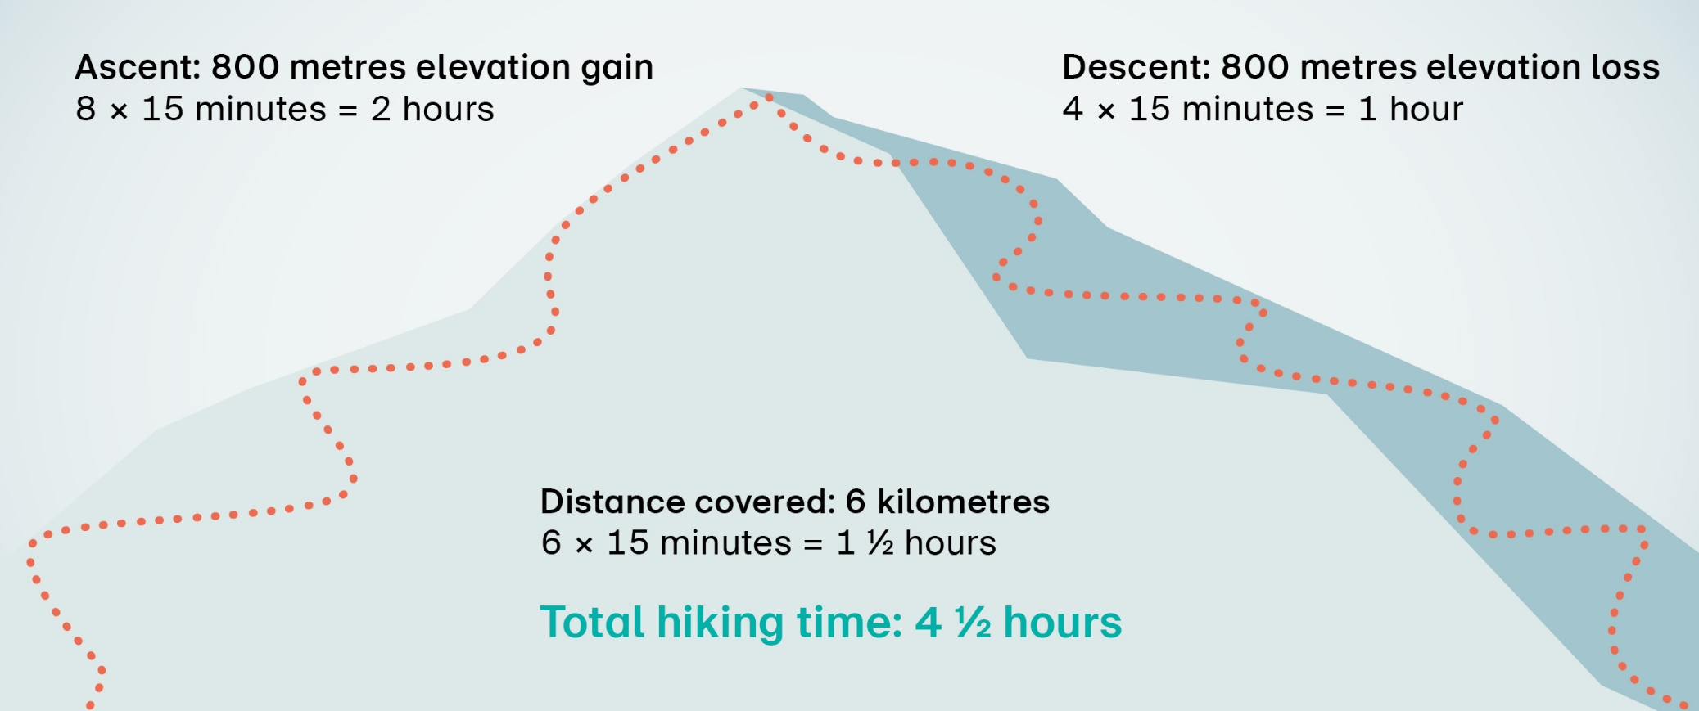
Rule of thumb for calculating hiking time (without breaks)
  Hiking time calculation (example):
  6-kilometre hike with 800 metres ascent and 800 metres descent

Slide 8
Trail categories
Hiking trails
are usually wide, but can also be narrow and uneven in places.
Besides the customary attention and caution, yellow hiking trails do not present any particular demands. Sturdy footwear with a grippy sole and weather-appropriate equipment are recommended.
Mountain hiking trails
are mostly steep, narrow and exposed in places.
Hikers not only need to be surefooted, physically fit and have a head for heights, but must also be familiar with the hazards associated with hiking in the mountains. In addition to sturdy footwear with a grippy sole and weather-appropriate equipment, carrying a hiking map is recommended.

Slide 9
Trail categories
Alpine hiking trails
lead in part over snowfields, glaciers or scree and through rocky terrain with short climbing sections – often without a visible path.
Hikers not only need to be surefooted, physically fit and have a head for heights, but must also be familiar with the hazards associated with hiking in the mountains. In addition to regular mountain-trail hiking equipment, a compass, rope, pickaxe and crampons may be necessary depending on the chosen tour.

Slide 10
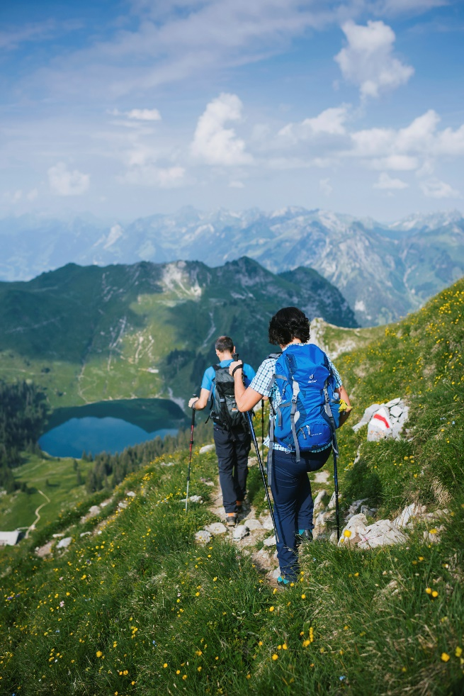
Be well equipped
  Sturdy hiking boots with grippy soles and good treads
  Warm clothing suitable for layering: sweater, waterproof jacket, possibly woollen hat and gloves
  Sunglasses, sunhat and sunscreen
  Up-to-date map
  Food, drink, penknife
  Hiking poles if required
  For emergencies: first-aid kit, rescue blanket, mobile phone
  → Find a packing list at https://sicher-bergwandern.ch/de/packliste (available in German, French and Italian)

Slide 11
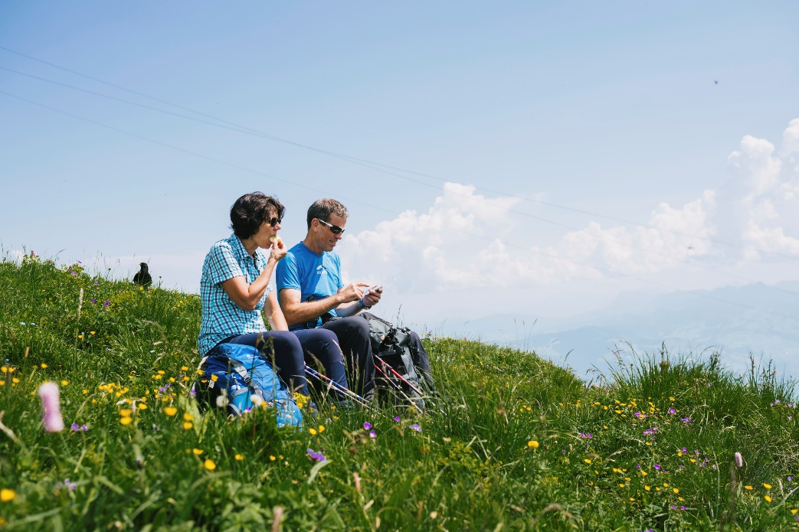
Be safe every step of the way
  Fatigue can seriously impact your surefootedness. Drink, eat and rest regularly to stay physically fit and focused.
  Keep track of your time schedule and any weather changes.
  Don’t leave the signposted trail – unofficial paths “off the beaten track” and supposed shortcuts can lead you astray.

Slide 12
Be safe every step of the way
  Turn back in time or seek shelter in a mountain hut – for instance if the weather is about to deteriorate.
  Lost? Stay together in the group and return to your last familiar location. In fog, wait for visibility to improve and do not descend through unfamiliar terrain.

Slide 13

  Video «Mountain Hiking»
Notes:
FR https://youtu.be/dM1svjNg_hI
IT https://youtu.be/5PBxqouiass

Slide 14
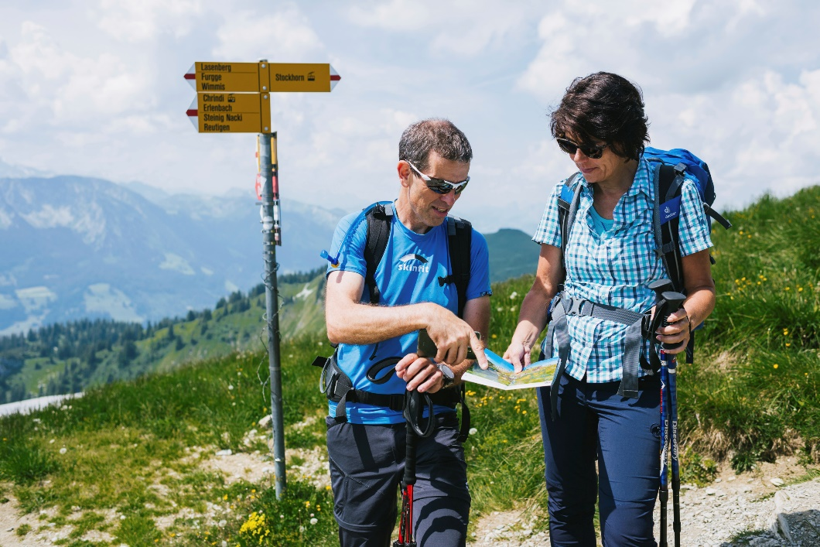
Do the mountain hiking check
  Plan
  What do I intend to do?
  Assess
  Is this hike suitable for me?
  Equipment
  Do I have what I need?
  Evaluate
  How am I doing?

Slide 15
In an emergency
  First: provide immediate life-saving emergency assistance to the injured person(s).
  Alert the rescue services as quickly as possible via the European emergency number 112 (contactable on all mobile networks and even on a locked phone) or via an emergency app.
  Don’t leave the injured person(s) on their own.
  Don’t neglect your own safety.

Slide 16
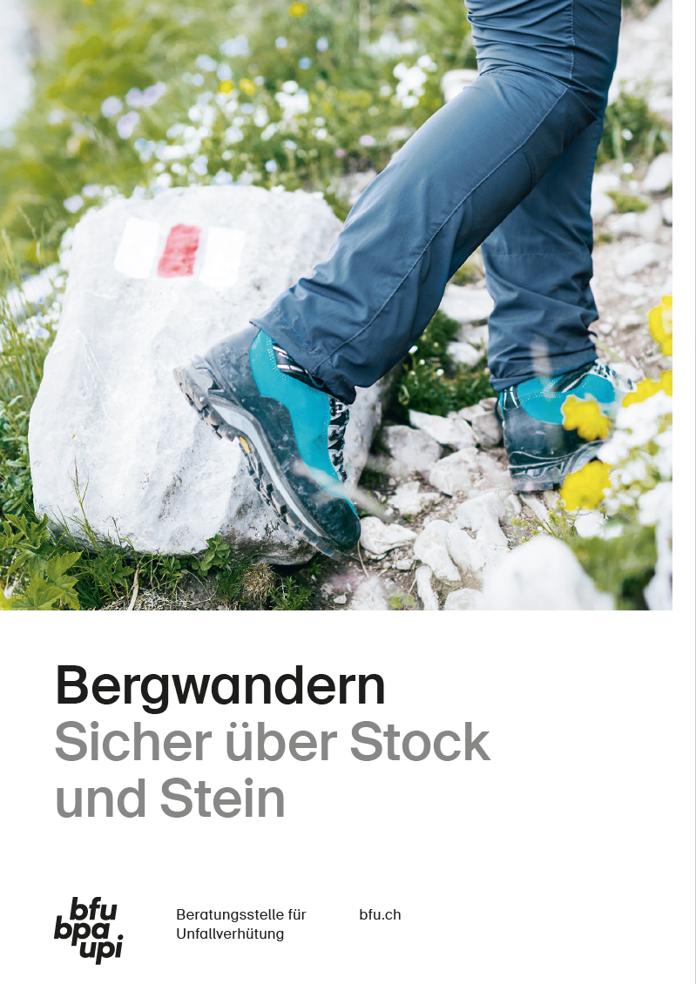
More information
Get more information on this topic in the BFU brochure «Mountain Hiking» (Art.-No. 3.010).
Order it free of charge at bestellen.bfu.ch.
Find more information on the campaign website
sicher-bergwandern.ch (available in German, French and Italian)
Find more accident prevention tips at bfu.ch.

