Slide 1
Slow down – stay safe
Company, event, date
Name

Slide 2
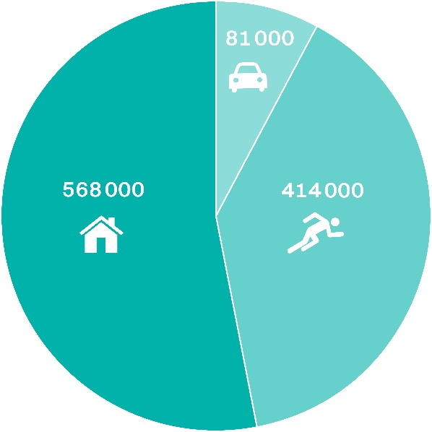
Non-occupational accidents in Switzerland, 2016
Every year, more than one million people are injured on the roads, when doing sport and physical activities as well as in and around the home.

Slide 3
Persons injured, by type of sport (Ø 2012–2016)
Type of sport Persons injured
Ball games 135 000
Winter sports 91 000
Skiing 53 000
Snowboarding 12 000
Cycling and skating (not in traffic) 32 000
Gymnastics, athletics 29 000
Mountain sports, hiking 26 000
Water sports 19 000
Other types of sports 81 000 Total: 413 000
Notes:
Persons injured in other sports (Ø 2012-2016):
Tobogganing 6550
Ice-hockey 5100
Cross-country skiing 4920
Ice-skating, figure skating 3660
Back-country skiing 930
Other winter sports 5310
Other types of sports include martial arts, bowling, throwing and hitting games, equestrian sports, dancing, motor vehicle racing
Find more information in the 2019 Status Report
https://www.bfu.ch/sites/assets/Shop/bfu_2.360.08_Status%202019%20%e2%80%93%20Statistics%20on%20non-occupational%20accidents%20and%20the%20level%20of%20safety%20in%20Switzerland.pdf

Slide 4
Over 90 % of all skiing and snowboarding accidents are self-induced.
This is why you should think ahead on the slopes, be pro-active and pay attention to the BFU tips.

Slide 5
Adapt your speed
Skiers and snowboarders are often travelling faster than they think and can quickly reach a speed of 50 km/h.
A collision with a stationary obstacle at this speed is comparable to a fall from 10 metres height.
→ Adapt your speed to your ability and the prevailing slope conditions – this massively reduces your risk of suffering an accident.

Slide 6
Do your pre-season prep
Strengthen your trunk and leg muscles with balance- and strength-training exercises.
Take a course – improve your technique under the supervision of a qualified snowsports instructor.

Slide 7
Be properly equipped – Skiing
Check your skis regularly and keep them properly maintained.
Have your ski bindings adjusted every year by a specialist retailer and checked with a testing device.
skivignette.bfu.ch

Slide 8
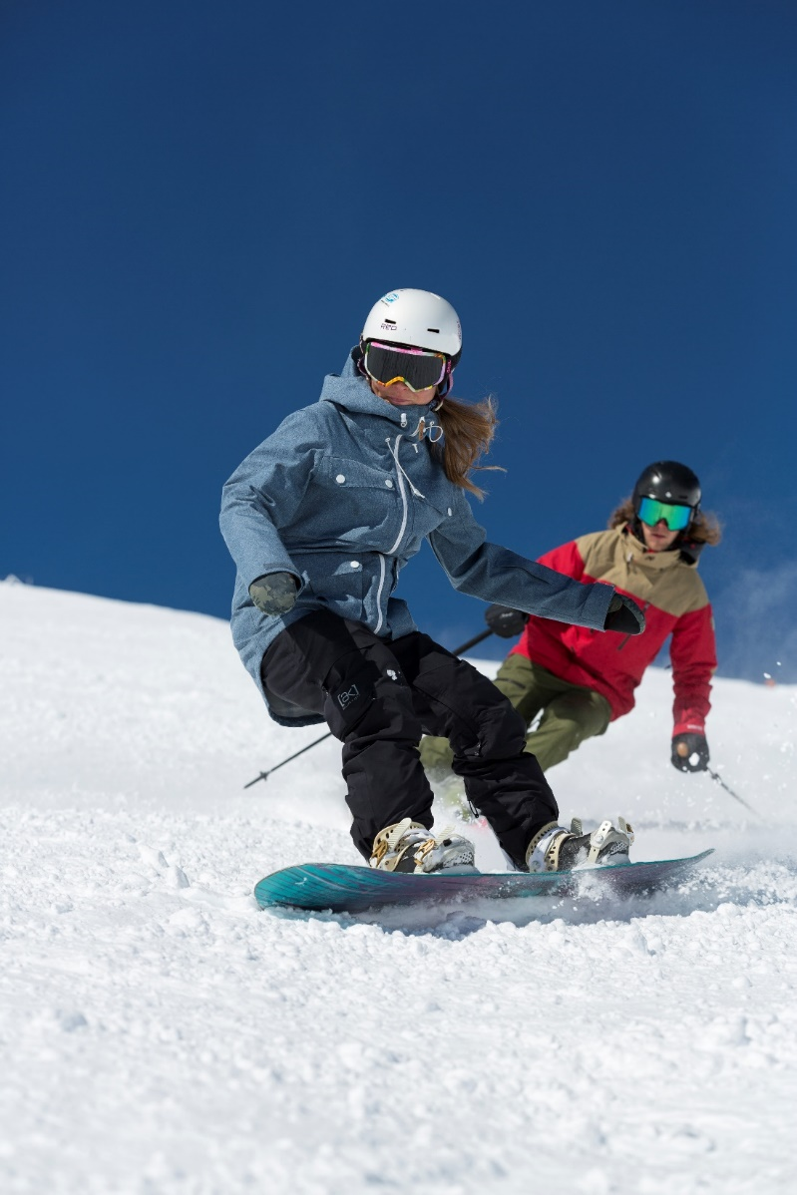
Be properly equipped – Snowboarding
Check your snowboard regularly and keep it properly maintained.
Tighten the screws on your snowboard binding and replace defective parts.

Slide 9
Be properly equipped – Clothing and protective gear
Wear warm, weather-proof clothing.
Wear a snowsports helmet – every sixth accident results in head trauma.
Novice snowboarders in particular should also wear wrist protectors.
A back guard gives added protection, especially in snow parks.
Don’t forget your contact lenses or prescription glasses.
Wear snow goggles/sunglasses with adequate protection against UV rays.
Notes:
Heb: Item 2 – every sixth accident results in head trauma.

Slide 10
Act responsibly – the 10 FIS and 3 SKUS rules of conduct
Personal responsibility takes top priority on the slopes. The International Ski Federation FIS has issued 10 binding rules of conduct for snowboarding and skiing:
Do not behave in a way that endangers or harms anyone.
Be alert and in control. Adapt your speed and manner of skiing to your personal ability and the prevailing terrain conditions.
When coming from behind, choose a route that does not endanger skiers or snowboarders ahead.
Leave ample space when overtaking.

Slide 11
Act responsibly – the 10 FIS and 3 SKUS rules of conduct
5. Look up and down the slope before entering a marked run, starting again or moving upwards.
6. Only stop at the edge of the slope or where you can be easily seen.
7. Keep to the edge of the slope when climbing or descending on foot.
8. Respect all signs and markings.
9. In the event of an accident: provide assistance, alert the rescue services.
10. Involved parties and witnesses must provide their names and addresses.

Slide 12
Act responsibly – the 10 FIS and 3 SKUS rules of conduct
Snowboarders: the Swiss Commission for the Prevention of Accidents on Snowsports runs SKUS has issued 3 additional rules:
1. Place your snowboard upside down (binding facing downwards) in the snow.
2. Remove your back leg from the binding when using ski- or chairlifts.
3. With alpine-style bindings, attach your front leg firmly to the board with a safety leash.

Slide 13
Video «Sicher die Piste hinunter.»

Slide 14
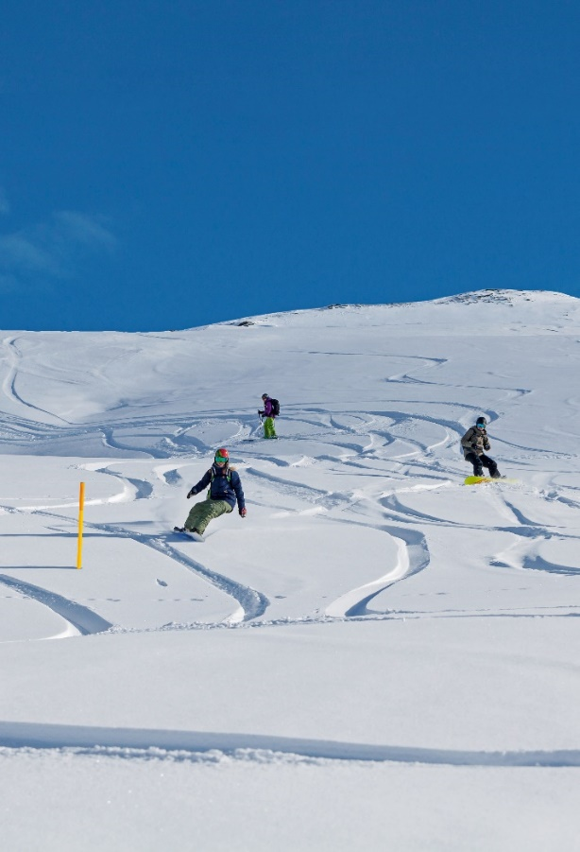
Freeriding: Safety first off-piste
The 5 key tips
Deep-snow skiing: use the secured, yellow-marked downhill runs.
Take an avalanche training course.
Abstain from freeriding when the avalanche risk on the five-level scale is 3 (considerable) or above.
Inexperienced? Join a tour led by someone well-versed in avalanche safety.
Carry a charged mobile phone and emergency equipment: an avalanche transceiver (rescue beacon), a probe and shovel

Slide 15
Video «Freeriden: Mehr Sicherheit beim Tiefschneefahren»

Slide 16
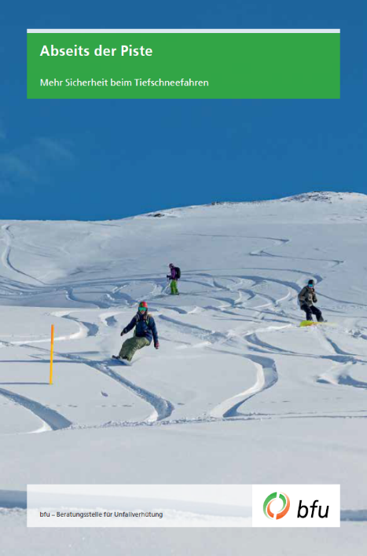
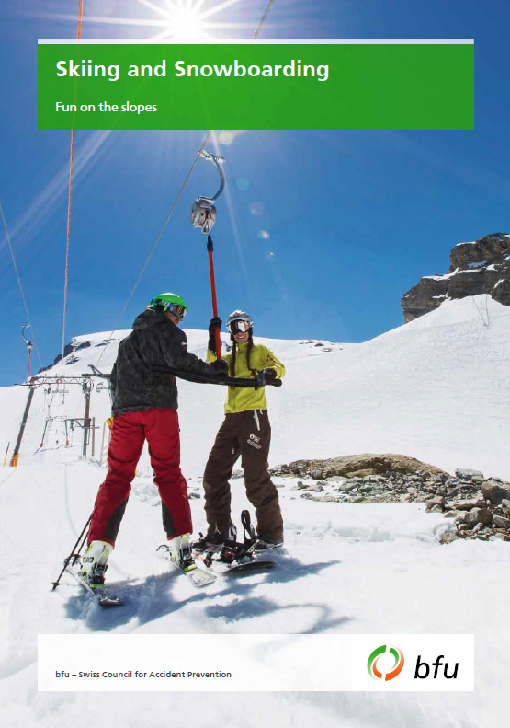
Further information
The following BFU brochures (available in French, German and Italian) contain more on this subject:
«Skiing and Snowboarding» (Art. no. 3.002)
«Abseits der Piste» – available in French, German and Italian (Art. no. 3.028)
Order them free of charge at bestellen.bfu.ch.
You can find even more accident prevention tips at bfu.ch.

