Slide 1
Falls are child’s play.
Company, Event, Date
Name

Slide 2
In Switzerland, falls are the most common type of accident in the home and leisure sector: over​
280 000 people are injured in this way every year.
60 %
are same-level falls.
Around ⅕ are falls from height or on a staircase.

Slide 3
Common causes of falls
  Impairments caused by alcohol or medication
  Impaired vision
  Decrease in strength and balance
  Illness-related impairments such as weakness, dizziness or pain
  Inappropriate footwear
  Inadequate infrastructure such as poorly visible steps, uneven staircases, lacking handrails, slippery flooring, railings that are too low or poor lighting
  Obstacles lying around that are trip hazards, e.g. power cords or loose rugs
  Own risk behaviour

Slide 4
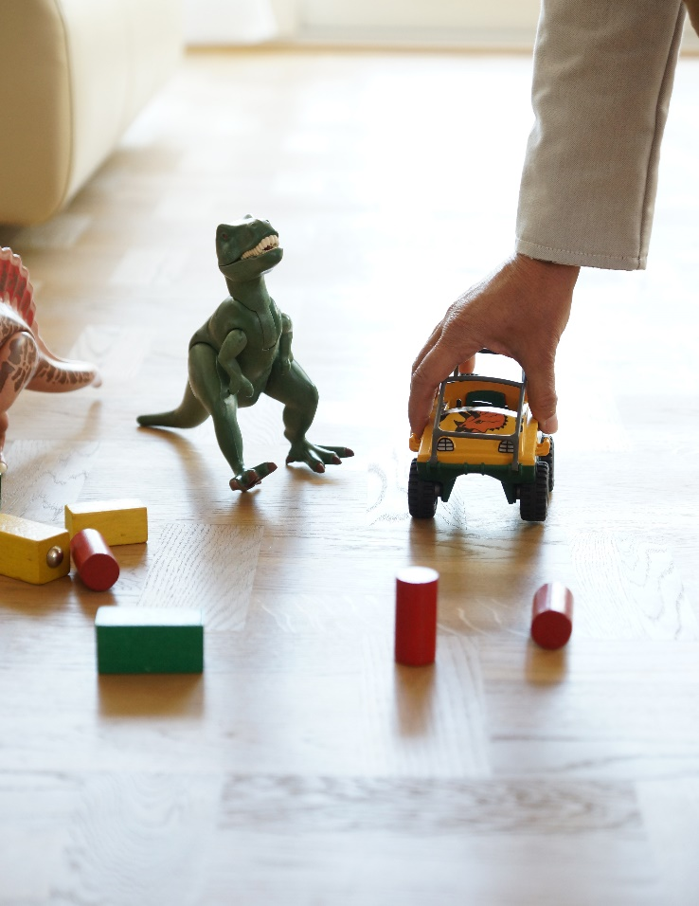
Banish fall hazards​
  Do not use hallways, staircases, entrances and traffic areas as storage space.
  Keep potential trip hazards (e.g. appliance cords, toys, shoes) safely out of the way.
  Secure loose rugs with a non-slip underlay and fix uneven edges down with carpet tape.
  Keep floors clean.
  Fit non-slip strips and handles in the bathtub and shower.
  Wear appropriate footwear.
.

Slide 5
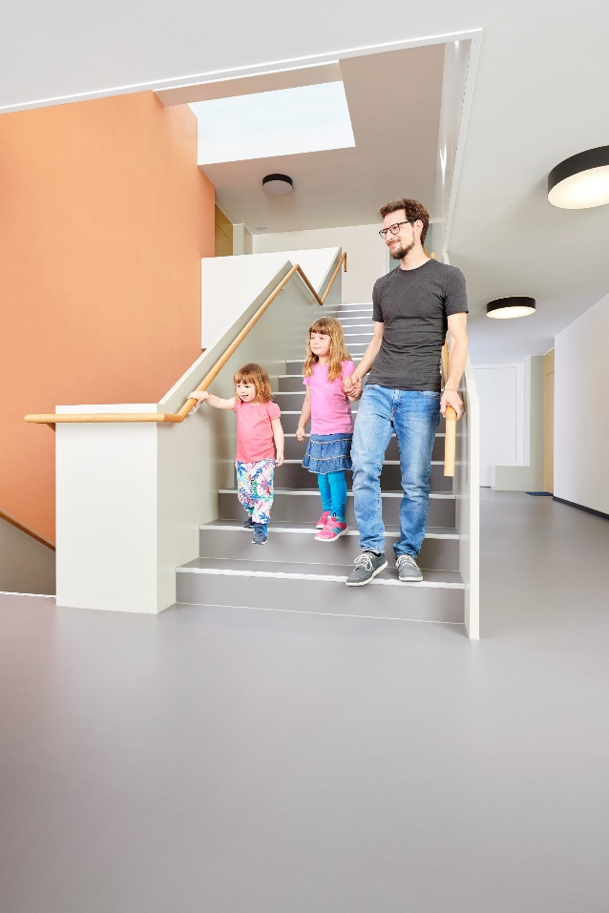
Make staircases safe
  Ensure adequate, glare-free lighting.
  Boost visibility by marking treads and poorly visible steps.
  Fix self-adhesive non-slip strips parallel to the edges of steps with a smooth surface.
  Attach a handrail on both sides of the staircase.
  Do not use steps as storage space.

Slide 6
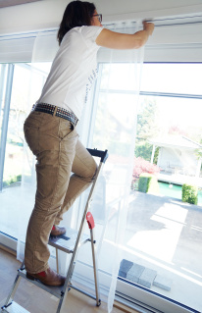
Use stable ladders
  Use a stable ladder when working at height.
  Choose a ladder with the following features: wide steps (instead of rungs), non-slip surfaces, stable rubber feet and a safety bar that reaches at least up to the knee.
  If there are children in the household – do not leave climbing aids near windowsills or balcony railings.
  Do not use a ladder after consuming alcohol.

Slide 7
Look where you’re going
  Even when under time pressure: stay focused and don’t rush.
  Look where you walk and watch out for uneven surfaces.
  Use the handrail on staircases. ​

Slide 8
Stay in balance
  Maintaining good balance is not just important in old age. It benefits us in daily life too: when doing all kinds of sports, climbing stairs, walking over uneven surfaces (such as over tree roots in forests, while hiking etc.), or when reaching for heavy objects from a height.
  Balance and muscle strength decrease from the age of 35 onwards. This is why the risk of sustaining serious injury from a fall increases with age. Regular training plays an important role in counteracting this natural decline.

Slide 9
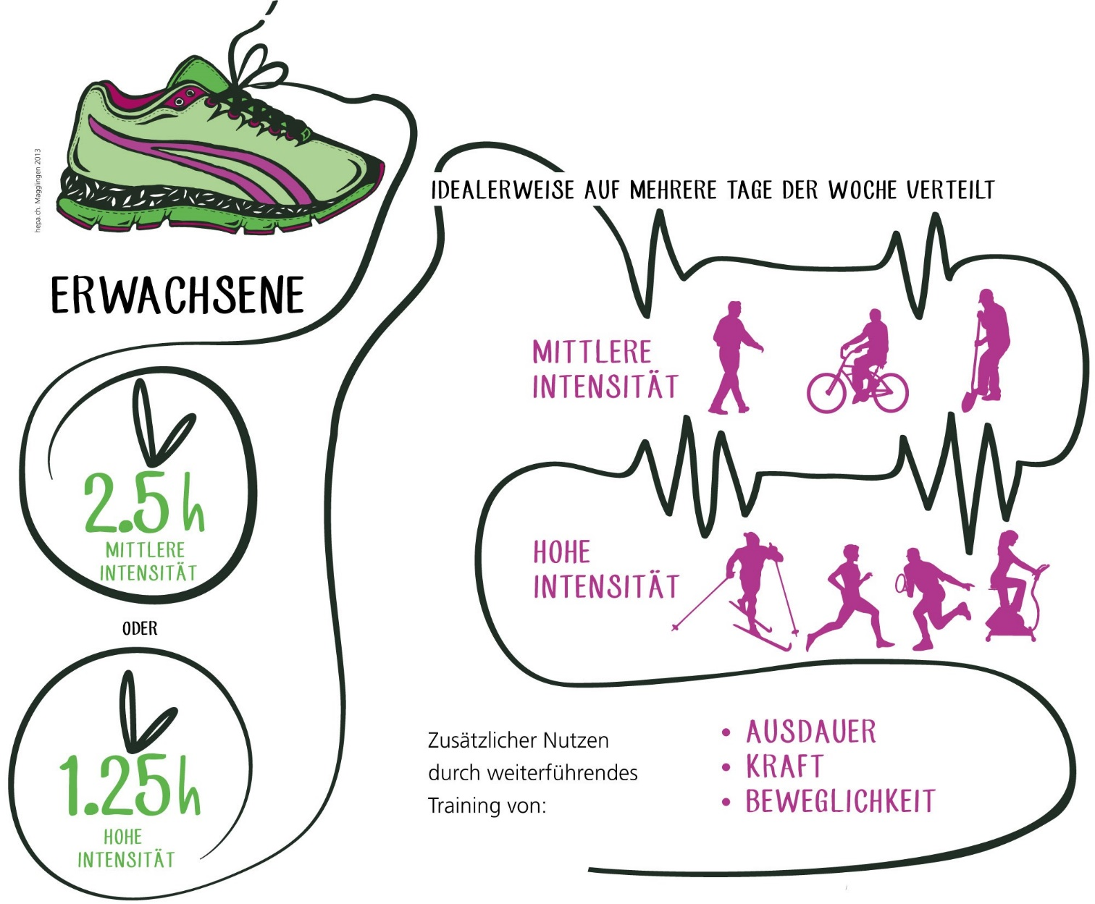
Exercise recommendations
  Get regular exercise. Follow the general recommendations for exercise.
  In addition, train strength and balance for 30 minutes, 3 times a week.
IDEALLY SPREAD OUT OVER SEVERAL DAYS A WEEK
ADULTS
MODERATE INTENSITY
2.5 HRS
MODERATE INTENSITY
HIGH INTENSITY
Additional benefits by further training in relation to:
ENDURANCE
POWER
FLEXIBILITY
1.25 HRS
HIGH INTENSITY
Quelle: hepa.ch
Notes:
https://www.hepa.ch/de/bewegungsempfehlungen.html
Basic recommendations for men and women of working age:
- At least 2½ hours of exercise per week, which can include everyday activities or sports of at least moderate intensity.
Or 1¼ hours of sports or high-intensity exercise.
Combinations of exercise at different intensities are also possible. For example, 10 minutes of high-intensity exercise have the same health benefits as 20 minutes of moderate intensity exercise.
Moderate intensity is physical activity that leaves you a bit out of breath, but not necessarily sweating. Walking, cycling, shovelling snow or gardening are examples of such exercise, but many other leisure, everyday or sports activities also have a moderate intensity.
Activities that cause at least minor sweating and accelerated breathing have a high intensity. These include movement-intensive sports that use large muscle groups, such as running, brisk cycling, swimming or cross-country skiing, but also cardiovascular training on fitness equipment. It is possible and useful to combine different activities and to vary them.
Ideally, the physical activity should be spread over several days a week. Each exercise unit of at least 10 minutes duration adds up over the course of a day. There are different ways to achieve the basic recommendations. For example:
½ hour of exercise of moderate intensity on 5 days a week.
½ hour of moderate intensity exercise on 3 days, plus ½ hour of high intensity exercise on 1 day per week.
These are minimum recommendations – any extra time spent exercising brings additional health benefits.

Slide 10
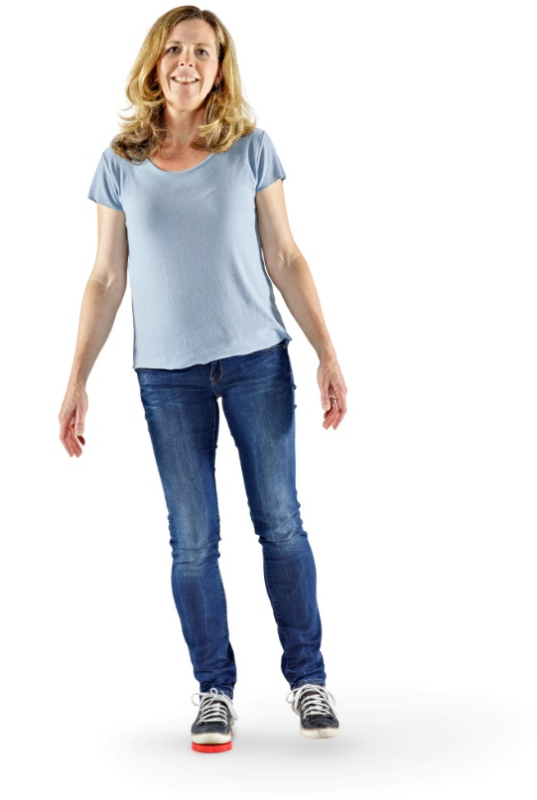
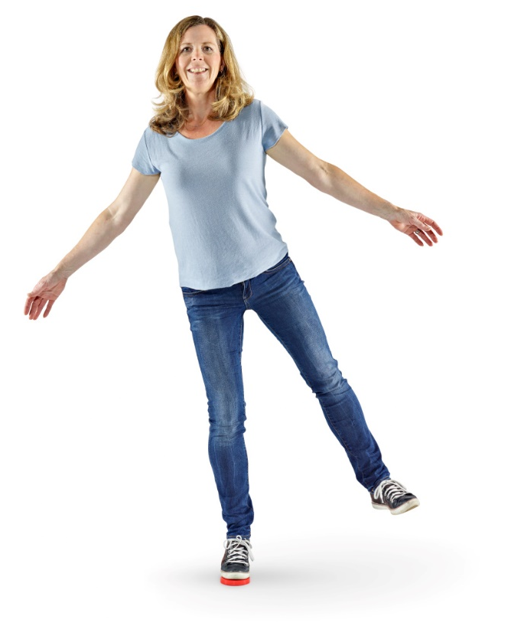
Train strength: lateral leg raise
  Basic exercise
  Stand with your feet hip-width apart and parallel. Shift your weight onto one foot and move your other foot sideways and outwards while keeping your upper body upright and your core stable. Bring your leg back to the starting position (without standing on it) and repeat the movement.
  Make this exercise more difficult by doing it on an unstable surface, e.g. on a balance disc, gymnastic mat (open or rolled), gyro balance board, Airex® Pad, or on soft, springy grass.

Slide 11
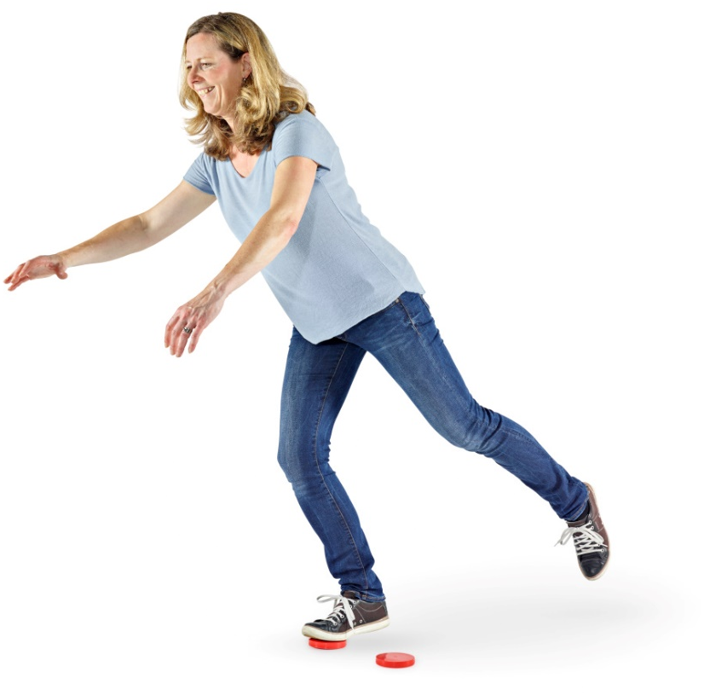
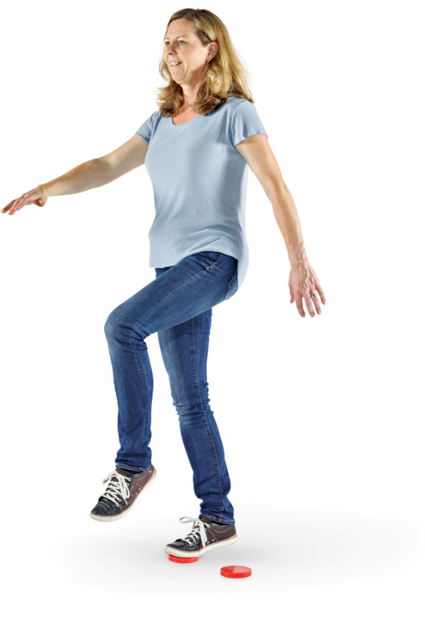
Train balance: standing on one leg
  Basic exercise
  Stand with your feet hip-width apart and tense your core muscles. Stretch one leg back as far as possible while bending the knee of your supporting leg slightly. Your upper body should be leaning slightly forwards. Then, swing your leg forwards without standing on it, bend your knee at an angle of up to 90 degrees and bring your upper body back to an upright position.
  Make this exercise more difficult by doing it on an unstable surface, e.g. on a balance disc, gymnastic mat (open or rolled), gyro balance board, Airex® Pad, or on soft, springy grass.

Slide 12

  Video «Falls»

Slide 13


More information
Get more information on this topic in the BFU brochures:
  «Stürze vermeiden» (Art. No. 3.026)
  «Checkliste für ein sicheres Zuhause» (Art. No. 3.004)
  «Selbstständig bis ins hohe Alter» (Art. No. 3.159)
They can be ordered free of charge at bestellen.bfu.ch.
Find more accident prevention tips at bfu.ch.

